Slide 1
Running an ERG effectively with minimal budget through global partnerships
Cass Averill
C Moulee
Oct 2017
Notes:
[Cass / 2 minute]
Thank you all for coming.
As the title here shows we’re going to be talking about running an ERG with minimal budget through leveraging global partnerships.
Logistics:
This is a dialogue – we will be asking you questions – we encourage you to participate
Feel free to raise your hand to ask questions or use the Q&A app
If you see a yellow "*" in the top-left of corner of a slide that means we’ll be asking you a question soon if you wanted to get your app out and ready.
We also very much encourage questions as we go
Handouts
Some printed available
Digital copy upon request (details given at end of presentation)
Why this particular topic?
Because shifting business objectives and political climates can greatly impact the amount of budget ERGs are granted or the time that individuals are allowed to work on ERG initiatives.
Something that PRIDE, Symantec’s LGBT ERG, has been successful with is finding ways around the barriers of time & money to still do good work
No matter your company size, how mature your ERGs are, or how much money you are allotted to run them, in this presentation we will provide you with tips and strategies for how to positively impact employees and internal corporate culture with minimal resources.

Slide 2
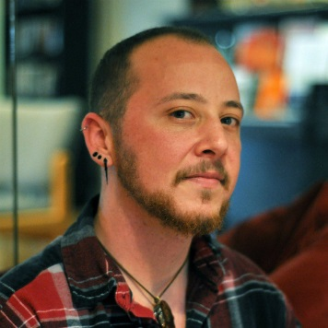
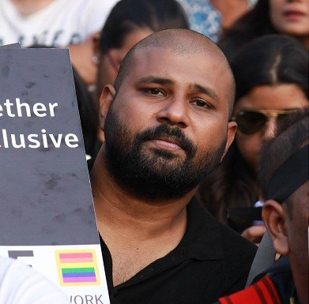
About the Presenters
Cass Averill Training Czar
C Moulee Sr Knowledge Engineer
Cass is based in Springfield, Oregon and is an out transgender man who publicly transitioned on the job 8 years ago. He is a passionate activist and has helped implement transgender healthcare coverage, all-gender restrooms, and global transition guidelines at Symantec. He leads his local LGBT ERG, and advises on LGBT-related policies and procedures. Outside of Symantec Cass is the President and Founder of Trans*Ponder; a nonprofit support, resource, and educational organization dedicated for the transgender/gender diverse community and its allies.
Moulee is based in Chennai, India, leads the LGBT ERG there, and was instrumental in starting Symantec’s first LGBT ERG in India. Outside Symantec Moulee is a vocal advocate for LGBT rights and engages with corporations and educational institutions to improve their diversity and inclusion efforts. He is a regular contributor to LGBT and mainstream news outlets in India and is in the process of documenting the contemporary Queer History of Chennai.
Notes:
[Cass / 5 minutes]
But first, a little about us.
Cass Averill
Based in Springfield, OR, USA and have worked for Symantec for the past 11 years.
I am currently the Training Czar for Endpoint Protection Support
And am also the PRIDE chapter champion for my local office.
I’ve been involved in running the ERG since 2011.
I got involved after experiencing some discrimination in accessing my healthcare benefits because of my transgender status (has since been resolved)
Since being involved with the ERG I have helped drive and implement:
Inclusive transgender healthcare packages
Global transition guidelines
Re-labeled all single-stall restrooms from gender segregated to “all gender” (in buildings we own)
As well as organized endless events, activities, and education campaigns that increase awareness on LGBT concerns.
C Moulee
Sr Knowledge Engineer – Norton Partner Solutions
Based in Chennai, India
Chennai PRIDE chapter champion
[how we started ERG/what we do in it]

Slide 3
Who is Symantec?
SYMANTEC Endpoint Protection
Who we are: The world’s leading cyber security company with more than 11,000 employees in more than 35 countries. Operating one of the world’s largest cyber intelligence networks, we see more threats, and protect more customers from the next generation of attacks; securing your most important data wherever it lives.
How we operate: To make the world a safer place, we need a team with the expertise and experience to protect against threats both known and unknown. This starts with a diverse workforce. Diversity helps us understand our customers better, enables us to respond to new trends quicker, and stimulates innovation.
What we offer: To the right is a sampling of some of our more well-known products…
SYMANTEC Advanced Threat Protection
SYMANTEC Data Center Security
NORTON Security
NORTON Core
NORTON mobile security
Norton & LifeLock Identity Theft Protection
Advanced Threat Protection
Notes:
[Moulee / 2 minutes]
So who is Symantec?
Who we are
We are the world’s leading cyber security company with more than 11,000 employees in more than 35 countries.
We operate one of the largest cyber intelligence networks; securing the world’s most important data wherever it lives.
How we operate
We also know that making the world a safer place for all requires a diverse workforce to help us better understand our customers and respond to new threats.
When people feel comfortable at work there is more collaboration, innovation, faster solutions and delivery of projects, and it is easier to implement change.
We believe that when you give people equal opportunity, amazing things happen.
What we offer
To the right of the slide here is a sampling of some of our more well-known products…
The most well-known of the mall being Norton Security (formerly known as Norton AntiVirus)

Slide 4
Agenda
01
Case Study and Comparison
ERGs by the numbers
What does all of this info mean?
03
Impact
What do we mean by impact?
Areas of impact
How do we measure impact?
How global collaboration affects impact
02
Budget
ERG Budgets 101
Regional funding differences
Budget vs. Impact
04
Strategies
Fundraising strategies
Collaboration strategies
Brand image
Management engagement strategies
Notes:
[Cass / 1 minute ]

Slide 5
Case Study and Comparison
01
Topics:
ERGs by the numbers
What does all of this info mean?
Notes:
[Cass]

Slide 6
Case Studies | Global Organizations
*
Employee Resource Groups by the numbers
U.S. Case Studies:
#1 | Symantec:
11,000 total employees (globally)
143 (1.3%) of those employees are LGBT ERG members
Annual ERG budget spent = $2.36 per employee per year
HRC CEI Ranking = 100%
#2 | U.S. Company X:
230,000 total employees (globally)
4,140 (1.8%) of those employees are LGBT ERG members
Annual ERG budget spent = $2.16 per employee per year
HRC CEI Ranking = 100%
Indian Case Studies:
#3 | Indian Company Y:
7000 Total employees (in India)
644 (9.2%) of those employees are LGBT ERG members
Annual ERG budget spent = $0.57 per employee per year (in India)
#4 | Indian Company Z:
7600 total employees (globally)
1000 total employees (in India)
No ERG in India, but a general D&I effort for all employees in India
Annual D&I budget spent = 4000 USD | 4 USD per employee
Notes:
[Cass / 5 minutes]
We collected information from companies in both the U.S. and India in regards to ERG engagement and funding. Let’s start by just having take a look at the numbers for a moment, and then tell us what you see? What story do these numbers tell?
TALKING POINTS:
A note to consider about these membership #s is how they are counted
Each company counts their membership differently -- email list sign up, ERG event attendance, event organization/participation, etc.
Currently India does not have any body that reviews the organization's equality index.
These #s really show that cultural context matters.
India is just getting started in the ERG world so their participation and engagement #s will look different than the US
Many Indian companies don't have official ERGs setup yet so accounting for these #s is more difficult if not impossible
US companies often have well established ERGs and ERG processes/procedures where many India companies do not (yet)
[OPTIONAL AUDIENCE QUESTION] – Does anyone want to comment on how your company compares to these numbers?

Slide 7
Case Studies | Takeaways
What does all of this information mean?
LGBTQ+ people need ERGs now more than ever
No reporting standards
Grass-roots efforts make a difference
Notes:
[Moulee / 2-5 minutes]
What these #s really show is the incredible need for more engagement (no matter the global region).
In the U.S. it is estimated that over 4% of the population (over 10 million Americans) are LGBT-identified
REFERENCE: http://news.gallup.com/poll/201731/lgbt-identification-rises.aspx
In India there are no official #s, but…
The government of India submitted figures to the Supreme Court in 2012, which reported about 2.5 million gay people. These figures are only based on those individuals who self-identified with the Ministry of Health.
In either case, we expect accurate numbers to be much higher than what has been reported.
The reason why these numbers don’t depict an accurate size of the LGBT population is because many LGBT people are still living in the closet - in fear for their safety and/or their lives.
Since we know the LGBT population #s are expected to be higher, and we know of the struggles they face across the globe (both inside and out of the workplace), it seems clear the need for support networks and advocacy groups are as great as ever.
No reporting standards
How any company reports the ERG members they have, let alone how many LGBT employees, varies from company to company.
With no data standards tracking ERG membership/engagement it can be hard to clearly advocate for spending budget on ERG initiatives.
Grass-roots efforts make a difference
Many organizations are working towards LGBT inclusion without a formal ERG.
This can be done through:
Being mindful to include LGBT workers in Employee Welfare Programs.
Introduce/expand policies to be inclusive of LGBT employees.
Participating visibly within the larger organization culture.

Slide 8
Let’s talk budgets
02
Topics:
ERG Budgets 101
Regional funding differences
Budget vs. Impact
Notes:
[Cass]

Slide 9
ERG Budgets 101
Budgetary guidelines, constraints, and priorities
Understand the process
Align to business initiatives and organizational values
Operational budget vs total funds spent
Is there wiggle room?
Notes:
[Cass / 3-5]
Budgets can vary greatly from one company to the next…:
Company-created ERGs often have a clearly defined and structured budget allotment that is provided at the beginning of each fiscal year or they will have a budget proposal process to navigate for each request.
Grass-roots ERGs typically start off with borrowed funds from other areas of the business, or no funds at all. This often means there are special considerations or processes to take into account when requesting budget for ERG activities.
Understanding what this process looks like and how the decisions are made gives you the best shot at your requests being funded
Aligning your requests with the mission, vision, and/or business objectives of the company lend you the best chance of your request being funded.
This will also give you insight into what alternative funding methods may exist
Operational budget vs total funds spent…:
Yes. Total funds spent being higher than the operational budget isn't inherently a bad thing.
Operational budget is often not enough to fund all the activities/events/partnerships/etc an ERG would like to do throughout a year.
This is where alternative funding methods come into play and how total funds spent may end up being larger than the operational budget for an ERG.
Why don't operational budgets cover everything…:
There are a plethora of reasons why a company may not grant all requested budgetary funds: company performance, financial forecasting, ERG performance, misalignment with company mission/values/objectives, organizational budget cuts, and more…
In some companies these reasons can change from one request to the next based on how the business is doing.
The important thing to remember here is to not take it personally if your request doesn't get fully funded.
This is where seeking out alternative funding methods comes into play
We will talk more about alternative funding strategies in a later section.
We will also provide a handout that outlines some strategies you can try at your organization.
But first, let’s discuss how your funding sources may vary from region to region… (next slide)

Slide 10
Regional Funding Differences
Local LGBT context drives these differences
Special considerations
Tips/Ticks for successful navigation
Notes:
[Moulee / 3-5]
Each region has different funding requirements
Why are there differences?
Requirements for each region may be different
3rd party presenters in all regions aren’t always able to offer services pro-bono
Use your personal/professional connections to help negotiate costs
How do we go about obtaining funding differently because of this?
The support structure for an ERG can vary from region to region.
For example:
At Symantec, ERGs in the United States work directly with Diversity & Inclusion when organizing events
India works with their local Human Resources department.
***Talk about what those differences are. Are there differences in how we ask for money, ask for support, who we have to work with to put on events, etc. really anything where there may be a differences in how we do things because of our regional/cultural differences.
What are some of those differences
The local LGBT situation drives the initiatives at the workplace.
The workshops required in the US might not be required in India in the same context
Region A might be inclined more to spend money in sponsoring events outside the organization to build brand visibility whereas Region B might have to do a lot of work internally to bring change. The approach itself would require a different funding strategy
Special considerations
Swags play an important role in spreading the word within and outside the organization. But not all region might get funding to procure swags. If Region A manages to procure swags, they can try to procure it for all regions
Tips/Ticks for successful navigation
Identity the Key regional differences.
Share funding (swag example) without affecting the local requirement

Slide 11
Budget vs. Impact
Don’t get stuck on the money
ERG success isn’t measured by how much money you spend
Remember why you started
Did you get involved with the ERG to fundraise, or to lend a hand in creating positive change?
Even small fish can make big waves
You don’t need big money to make a big impact
Notes:
[Cass / 3 min]
Don’t get stuck on the money
Impact is not measured with money. No matter if you’re a small company or large, have lots of money or little, ERGs can and do influence positive change. In fact, that’s the whole purpose of an ERG, to spread awareness and influence policy and cultural changes on issues of concern to the demographic they serve.
Remember why you started
Sometimes its easy to get caught up in process and procedure and forget what drove you to get involved with the ERG in the first place.
Even small fish can make big waves
Even just 1 person can affect great change inside a company.
Company funded and grass-roots ERGs alike are helping make the workplace safer and more inclusive to all.
In fact, you can impact someone's life positively without spending any money at all
EXAMPLES:
Be a support person / lend your ear to a fellow employee when they are in need
Offer to help advocate for someone when they feel they aren’t being heard
Lend your expertise and skills to a ERG project
Be a mentor
Impact is highest when personal connections are made

Slide 12
Impact
03
Topics:
What do we mean by impact?
Areas of impact
How do we measure impact?
How global collaboration affects impact
Notes:
[Cass]

Slide 13
Define first, then take action.
What do we mean by impact?
“In business, impact is the measure of the tangible, and intangible, effects (consequences) of one thing or entity's action or influence upon another.” - BusinessDictionary.com
An ERG’s level of impact (effectiveness) is dependent upon the overall passion and commitment of its membership as well as the benefits (incentives) members receive for participating.
Notes:
[Cass / 2 min]
When we talk about impact in business “it is the measure of the tangible, and intangible, effects (consequences) of one thing or entity's action or influence upon another”.
An ERGs level of impact (effectiveness) is dependent upon the overall passion and commitment of its membership AS WELL AS the benefits (incentives) members receive for participating.
Notice how funding is not a dependency to achieve impact.
This is because it takes more than just money to make an ERG ultimately successful
It also takes passionate people who are committed to the cause
And to keep those passionate people engaged and prevent burnout - recognition and reward for their time, dedication, and accomplishments are a must
Even the most passionate and committed people can burn out when all their hard work goes unnoticed.
RESOURCES:
Definition pulled from BusinessDictionary.com (http://www.businessdictionary.com/definition/impact.html)

Slide 14
Areas of Impact
ERGs impact business through three primary avenues
Internally: The individual level
Culturally: The company level
Externally: The community level
Company Culture How the ERG affects company culture?
Employees feel represented and valued
Drives policy & procedural changes
Implements guidelines and best practices for navigating difficult situations
Improves external image through community networking and partnerships
Notes:
[Cass / 5 min]
Let’s take a moment now and talk about how ERGs can impact a company.
There are three primary areas of impact that we’ve identified and those are
Internal (affecting the individual)
Cultural (affecting overall company culture)
External (affecting the community at large)
Many are able to see how ERGs positively impact the individual and the community. It is often harder to inherently see how ERGs positively impact the company.
The three primary ways they do this is by:
Affecting internal culture
company vitality
and talent management
How exactly does an ERG affects company culture?:
They result in employees feel represented, safe, seen, heard, valued, and respected.
They ensure equality and inclusion is built into the fabric of the company by driving policies & procedures that clearly protect LGBT employees from discrimination or unfair treatment.
They implement guidelines and best practices for how to navigate special situations, issues, or conflicts that are specific to LGBT employees.
And the external community partnerships that an ERGs engages in shows employees that the company cares not just about their business and the people they employe, but also about the communities in which their business resides

Slide 15
Areas of Impact
Company Vitality How the ERG affects business outcomes?
Increases employee job satisfaction
Increases performance and higher quality output
Improves internal/external image
Improves customer relations
Improves talent acquisition & retention efforts
Talent Management How the ERG affects the talent pool and recruitment efforts?
Provides skill building, mentorship, and professional development opportunities
Diversifies the workforce & promotes innovation
Promotes brand awareness
Notes:
[Moulee / 5-7min]
Company Vitality :
Individuals feeling seen and represented at work results in increased performance, happiness, and confidence in their jobs.
The company experiences increased performance and higher quality output when employees feel safe, seen, heard, valued, and respected at work.
Increasing LGBT awareness throughout the company helps improve internal culture, external image, customer relations, and talent acquisition/retention efforts.
To help drive some of this home, there are some enlightening statistics on the subject from a 2014 HRC study that found:
53% of LGBTQ workers in the U.S. still feel like they have to hide who they are at work.
35% feel like they not only have to hide, but specifically lie about their personal lives to preserve their jobs and personal safety.
The business impact of this is that employees who have to hide who they are at work have significantly reduced productivity (up to 30% less than those who do not have to hide who they are).
Talent Management:
LGBT Individuals benefit greatly by seeing themselves represented in the ERG and knowing that they are not alone.
ERGs also provide avenues for skill building, mentorship, and professional development through peer support.
Intentional LGBT talent recruiting and retention efforts result in a more diverse workforce. Diversity of thought and unique perspectives are the heart of innovation. Innovation is what keeps a company on the cutting edge in their industry.
The external networking that ERGs do out in the community create increases awareness about the company’s inclusive internal culture; this can result in increased recruiting opportunities.
Sponsorship recipients, grant recipients, or any community partnerships a company has also affects brand image and talent management
REFERENCES:
Reference: The Cost of the Closet and the Rewards of Inclusion - Why the Workplace Environment for LGBT People Matters to Employers http://hrc-assets.s3-website-us-east-1.amazonaws.com//files/assets/resources/Cost_of_the_Closet_May2014.pdf

Slide 16
How do we measure impact?
*
Common Areas of Measurement
Membership
Number of members
Membership retention
% of total employee population
Total number of chapters
Events
Number of events
Attendance
Participation
Feedback
Employee engagement surveys
Event feedback
Testimonials from employees
Senior leadership feedback
Management Engagement & Participation
External Partnerships
Number of partnerships
Number of volunteering opportunities / volunteers
Business Objectives
How the ERG influenced or affected business objectives.
Notes:
[Cass / 3-5 min]
How does an ERG measure impact?
Small or new ERGs often measure success or impact by the number of active members it has, event participation, and feedback received through engagement surveys.
Larger and more mature ERGs will often align their goals to business objectives and measure their impact based their ability to affect change in those areas.
The primary ways we see ERG impact measured is through
Membership numbers
Event or activity management
Direct feedback
Management engagement and participation
External partnerships
And how well an ERG aligns with or influences business objects
QUESTION FOR AUDIENCE: Does anyone use or know of any other ways to measure ERG impact or success that isn’t already represented in this list?

Slide 17
How does collaboration affect impact?
“Stop, Collaborate, and Listen” – Vanilla Ice
Collaborating across regions raises awareness, leads to greater cultural understanding, and opens pathways to share resources, communication templates, events, activities, and ERG strategies.
Notes:
[Cass / 5-7 min]
And finally let’s talk about how collaboration affects impact.
The moment I thought about how collaboration works in business I thought of Vanilla Ice. He told us to “Stop, Collaborate, and Listen”
Every global region has its own set of unique issues, concerns, achievements, and important events (holidays).
Collaborating cross-regionally raises awareness, leads to greater cultural understanding, and opens pathways to share resources, communication templates, events, activities, and ERG strategies.
Why should each ERG chapter have to recreate the wheel?
Did you have a successful event, poster campaign, newsletter, membership drive or engaging activity? Share it!
Each chapter or region can revise and alter the information to fit within their context.
Examples and templates can breathe new life into small, new, or stagnant ERG chapters
Collaborating saves the company time, money, & resources.
Examples:
USA chapter creates Transgender Day of Visibility poster to increase awareness about the holiday and shares it with all global ERG chapters.
India chapter updates the poster with regional specific information and uses it for their own internal awareness campaign.
India chapter sends an educational email about Pride Month (what it is and why it matters) to their membership and CC’s ERG chapter leads from other regions.
USA updates the email with regional specific history and information, turns it into a poster, and uses it as a visual education campaign during Pride Month around the office.

Slide 18
Strategies
04
Topics:
Fundraising strategies
Collaboration strategies
Brand image strategies
Management engagement strategies
Notes:
[Cass]

Slide 19
Fundraising Strategies
*
What fundraising options exist outside of the official ERG budget?
Source funds from multiple departments/business units
Partner with other ERGs or business groups to reduce overhead
Apply for grants from the company’s charitable foundation (if there is one)
Approach ERG executive sponsor(s) for funding assistance.
Notes:
[Cass / 5-10 min]
Source funds from multiple departments/business units:
This way no single person or department has to fulfill the entire funding request.
It helps to have a clear business case for the value this budget request will provide the company as well as an itemized breakdown of how the funds will be used.
Partner with other business groups or ERGs to host activities
This will split the associated costs across all groups involved.
Example:
Co-host a “Ally 101” workshop with multiple ERGs inside the company. In this scenario we can all learn to be allies to each other and share both the organizational (planning) burden along with the financial burden associated with the event.
This approach helps to create a community-focused culture and mindset in the company.
Apply for grants from the company’s charitable foundation (if there is one).
Approach ERG executive sponsor(s) for funding assistance.
Sponsors often serve as an alternative funding source for ERGs.
You can also approach other executives, who are not official ERG sponsors, to see if they will sponsor an individual activity or event for the ERG.
Example: You want to attend a conference but don’t want the expense to take away from your ERG budget which would result in less money for other ERG activities throughout the year.
Make a business case justifying the request and proving explanation of the value of the investment.
Be sure to mention not just the value it brings to you the individual, or to the ERG, but to the company as a whole.
Itemize and give options
Provide details the cost breakdown and where the funds will go (it might help to show where you already have funding and what it is supporting!).
Highlight key portions of the budget request that need priority funding and provide short explanation.
Secure manager-level assistance
Seek out support from management to make the request (provide business case above!).
Strategize with management about what departments or groups you should solicit budget from.
Then, ask for their assistance in making the request as their support & assistance may give your request more weight or they may have a relationship with a key stakeholder that would help secure the budget.
[optional if there is time]
QUESTION FOR AUDIENCE: What other strategies have you used to obtain funding for your ERG beyond standard budget allowance.

Slide 20
Collaboration Strategies
How to best leverage ERG chapters around the world
Share resources & best practices (across regions and ERGs)
Virtual meetings
Global ERG Newsletter
Utilize collaborative technologies
Establish cross-regional mentorship programs
Notes:
[Cass / 5-10]
Share resources and best practices
Share documents, best practices, handouts, posters, flyers, event proposals, workshop outlines, presentations, successful engagement activities, etc. across all regions.
Utilize a document sharing tool like SharePoint, Google Drive, Box, or Drop Box for version control and easy access.
Send out an email blast when new resources are uploaded and lessons learned from the event/activity.
Don’t limit to sharing with other LGBT ERG chapters; be sure to include all ERGs across the organization, such as with the Women's, Veteran's, or People of Color ERGs. The intersectionality in the membership between ERGs is undeniable and we can support progress across the board by sharing information.
Virtual meetings
Internal virtual meetings enable multiple geographical locations to sync up and share information, current events, and resources
Set these up to recur monthly or quarterly depending on audience and agenda.
External virtual meetings enable collaboration with outside organizations’ ERG/BRG
This is particularly helpful for smaller organizations who have small grass-roots ERGs or who are looking to create a ERG
Global ERG Newsletter
Newsletters lend an opportunity to showcase the good work that each ERG is doing around the globe.
This is also an opportunity to promote cultural awareness through sharing regional current events
Such as regional holidays and information on the local political climate for LGBTQ individuals
Be mindful to not use language that is too skewed towards one particular region when speaking to a global audience (such as saying Dollars when referring to money when not all countries use Dollars for currency)
Utilize collaborative technologies
Using technologies such as Box, Google Drive, and DropBox assist in cross-regional collaboration.
This enables centralized cloud-based repositories for ERG files and documentation.
A great example of this was Moulee & I using Box to collaboratively create this presentation.
Establish cross-regional mentorship programs
This will help increase cultural awareness and sensitivity.
Increases business value when we understand our diverse employees
Increases communication between employees
Officially established mentorship programs create a “safe-space” to learn about cultures and ways of being that are different from your own.
They raise awareness and expand social skills enabling employees to better support and understand their fellow co-coworkers.

Slide 21
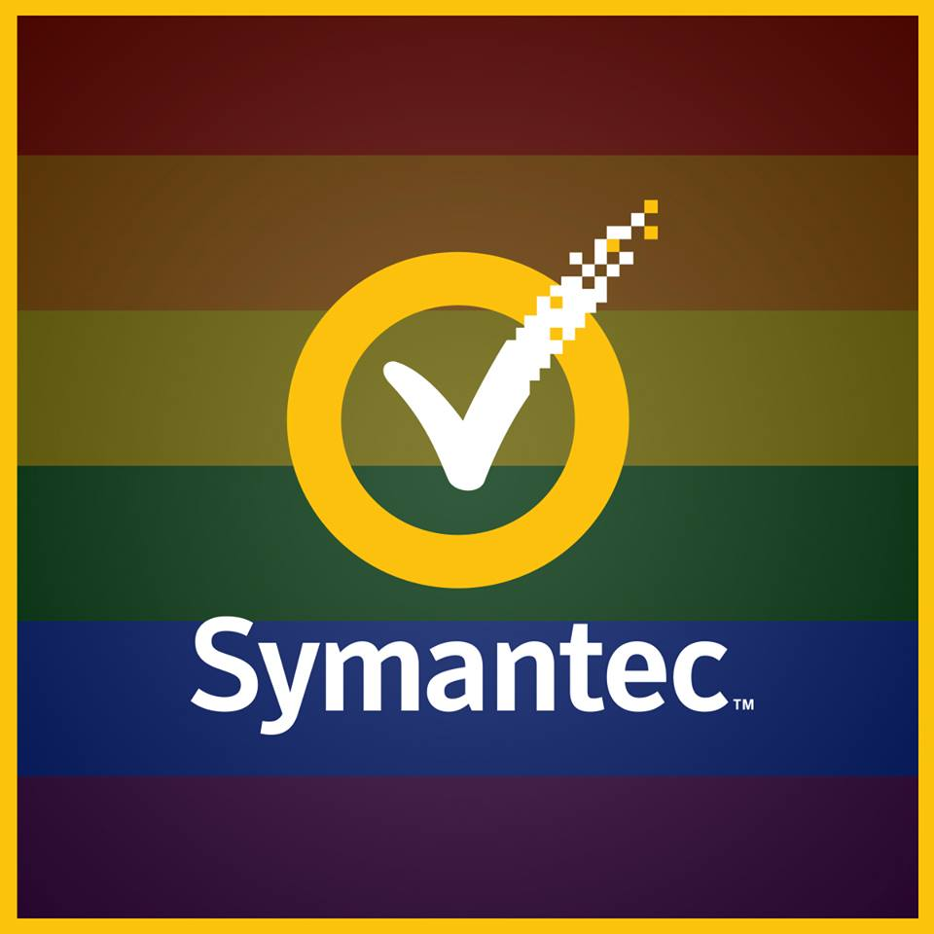
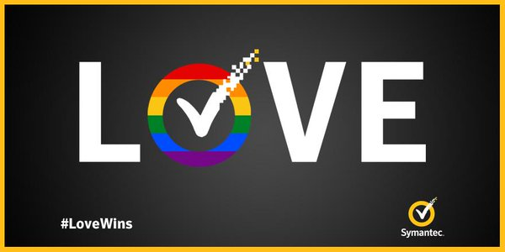
Brand Image Strategies
*
Internal strategies
Partner with D&I
Partner with Communications/Marketing teams
External strategies
Sponsor (financial support)
Volunteer (resource support)
Get political
Notes:
The ripple effect
The importance of visible support
Brand Loyalty
Notes:
[Moulee / 6-7 min (including following 2 slides)]
Internal strategies
Partner with D&I
ERGs can partner on D&I initiatives to help drive change throughout the organization. Policy/procedures changes and cultural changes.
Partner with Communications/Marketing teams
Partnering with both internal and external comms/marketing teams can help to ensure language is inclusive in all communications/advertisements.
Ensures that the visuals being used to represent the company is inclusive of LGBT people
Help promote ERG events, milestones, community partnerships, etc.
Help communicate ERG wins both internally and externally.
External strategies
Sponsor community events (such as festivals, parades, fundraisers, educational events, memorials, etc.).
Volunteer at community events
Take a political stance.
Sign political statements (such as amicus briefs)
Make official political endorsements
Publicly partner with LGBT advocacy groups
Publish position pieces about political events
Notes
The ripple effect
Public displays of support impact how customers feel about our brand
When these displays cause a response, this is what we mean by ripple effect.
Example #1: Cass did an interview with a state-wide newspaper about his transition in the workplace and how the company handled it. A state-wide LGBT advocacy organization, the largest in the state, saw the article and awarded Symantec with their “Champion for Transgender Equality” award.
This award ended giving Symantec a lot of positive PR, particularly within the LGBTQ communities
Example #1: U.S. legalizes same-sex marriage. Symantec responds with a #lovewins ad campaign changing the colors of our logo to symbolize our support.
This logo spread far and wide and was an obvious visual support aid
The importance of visible support
The #IAmTech series by Symantec published Moulee's journey in Symantec starting the LGBT ERG. The article got good response and was picked up by the Indian media.
Based on the #IAmTech series, India Today magazine carried a story about Moulee and listed him as one of the Change Makers in their Aug 2016 edition supplementary. - http://indiatoday.intoday.in/story/the-game-changers-sofia-ashraf-sriram-ayer-shravan-krishnan-arun-krishnamurthy/1/743953.html
Brand Loyalty
In a world where being LGBT can still cost you your life, being open and obvious in our support can really result in life-long customers. More and more consumers are concerned not with just the product, but the values and political stance of the company creating that product as well.
Retention of LGBT employees increases and also becomes one of the preferred employer for LGBT individuals, especially in a country like India where not all the companies are LGBT friendly.
Increases the brand value among allies and the LGBT community.
QUESTIONS FOR AUDIENCE: What other brand strategies do you use in your company to support the ERG?

Slide 22
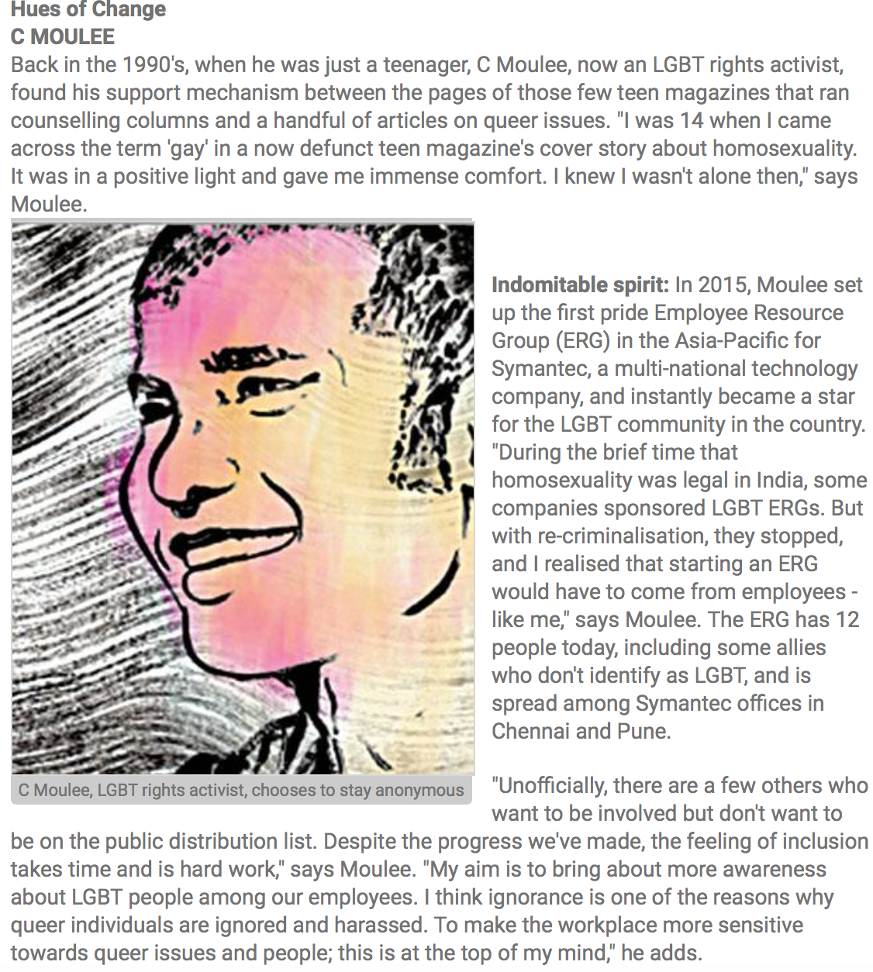
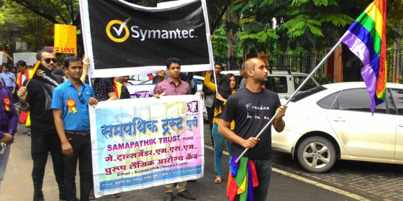
Brand Image
Examples
India
Notes:
[Moulee]
Based on the #IAmTech series, India Today magazine carried a story about Moulee and listed him as one of the Change Makers in their Aug 2016 edition supplementary. - http://indiatoday.intoday.in/story/the-game-changers-sofia-ashraf-sriram-ayer-shravan-krishnan-arun-krishnamurthy/1/743953.html

Slide 23
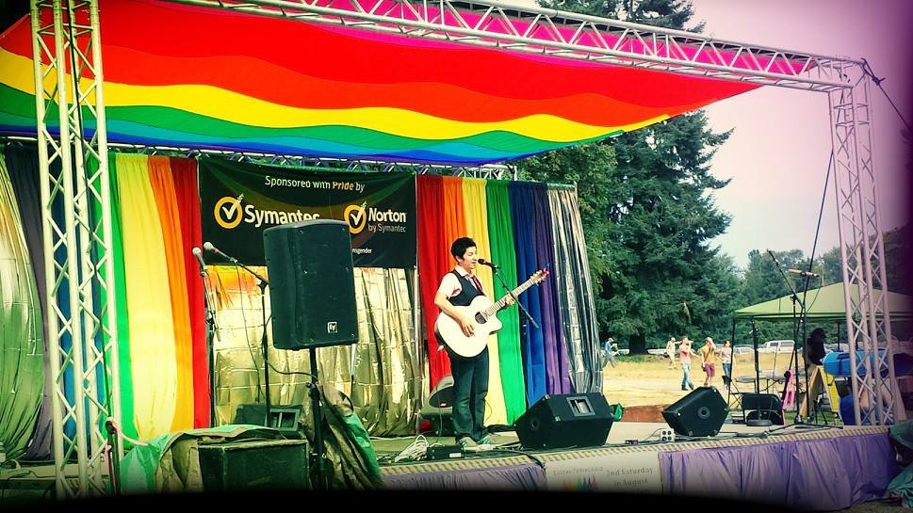
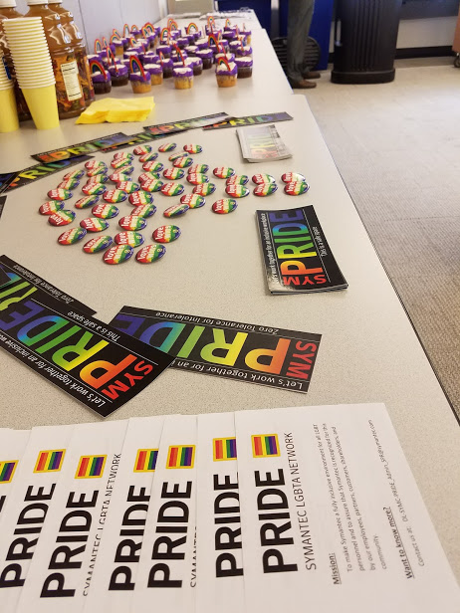
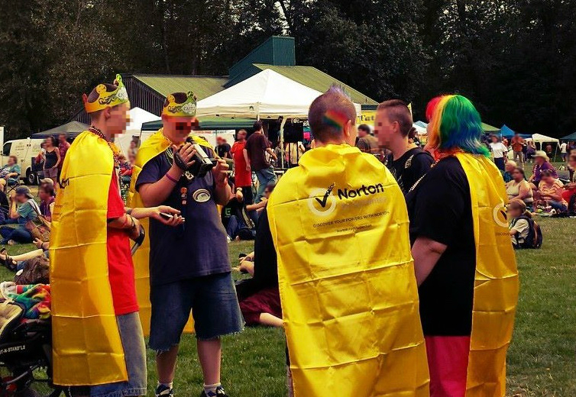
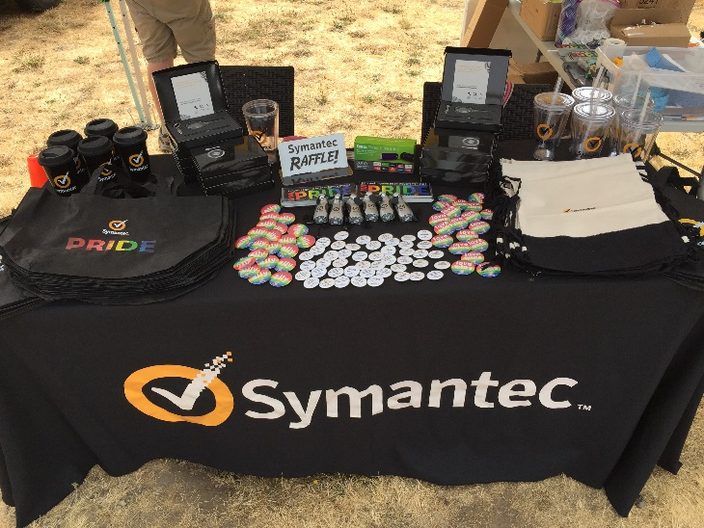
Brand Image
Examples
America
Notes:
[Cass]

Slide 24
Management Engagement Strategies
*
How to be an active ally as a manager
Get Involved:
Promote the vision and mission of the ERG
Be the spokesperson of the ERG
Participate:
Help drive ERG participation by encouraging your peers and team to join
Lead by example: show up!
Be a speaker and role model
Provide Financial Support:
Sponsor specific ERG events
Sponsor miscellaneous ERG expenses like food, swag, printing, etc.
Notes:
[Moulee / 10 min]
Get Involved
Leaders who believe in LGBT inclusion can and should use their voice to promote the ERG and the importance of inclusion in the workplace. ​
EXAMPLES: ​
Share articles related to workplace equality with your team via emails, in team meetings, newsletters, and/or on professional social media platforms (such as LinkedIn).
Forward ERG newsletters and events to your team stressing their importance and encouraging each team member to participate
Recognize and reward employee's ERG achievements in team meetings, newsletters, and/or emails.
Encourage your team member to share their experiences during team meetings on what they've learned or the skills that they're building through their involvement with the ERG.
​
Participate
Attend ERG meetings and events
Your mere presence speaks volumes and shows employees that you mean what you say.
If you don't show up, why should your employees?
Provide financial support where you can
Identify avenues for assisting an ERG financially.
Can your team budget help cover any costs?
Advocate for ERG financial assistance with other departments or business groups
Consider chipping-in to help cover small ERG-related expenses, such as:
printing or multimedia costs
SWAG purchases
Raffle items
Registration costs
Booth fees
Food costs
Travel expenses (transportation, lodging, food, incidentals, etc)
If you can't cover all travel expenses, can you cover some?
​
QUESTIONS FOR AUDIENCE: What other strategies management engagement strategies do you use in your company?

Slide 25
Summary
*
Key takeaways & questions
Be a vocal supporter
Identify and support ERG champions and leaders
Collaboration makes all the difference
Lead by example
Passion drives impact
Notes:
[Cass / 3-5 min]
Be a vocal supporter
It happens that for many employees the workplace is their only safe-space.
Realize the voice a leader has in the organization and try to be as vocal as you can to maintain or to expand that safe space.
A leader’s voice carries more impact than an individual
Identify and support ERG champions and leaders
Your support not only brings visibility to the cause, it also identifies you as a 'safe-person' for LGBT employees to approach for support in times of need.
This also sends a message to employees that any sort of bullying, harassment, or inappropriate comments will not be tolerated.
Collaboration makes all the difference
None of us have to do this work alone, as a matter of fact, the whole point is so that we don’t have to.
Collaboration (a.k.a. sharing) makes everyone’s lives easier.
Talk to each other
Share ideas
Include other groups and regions in the conversation
Co-host events
Co-facilitate activities
Collaboration can alleviate pressure on individual resources by spreading the workload. As they say, many hands make light work. In this globally connected world there are more hands available to help than ever before.
Take notice and use this to your advantage.
Lead by example
At the end of the day everyone wants to feel acknowledged, appreciated, and see a career path for themselves at work.
Being a change maker in the workplace may not directly apply to one’s job description but does provide experiences that promote personal growth, encourage collaboration, and develop teamwork and leadership skills.
Support is best shown with action – don’t just talk about it, live it
Passion drives impact
You don’t need a lot of funding to do good work
Remember, ERG success isn’t measured by how much money you spend
Even just 1 person can affect great change inside a company.
Passion and persistence make all the difference
Q&A – any final questions for us?

Slide 26
Thank you
Notes:
Remember to:
Remind about printed handouts available
Remind about SWAG
Remind that they can leave us their business cards to get a digital copy of materials after the conference
Or use sign-up sheet if they don’t have a business card

