Slide 1
Your Journey to ERG Success
Bank of the West
OUTWEST
An LGBTAQ Resource Group
Understanding and developing the key elements of a successful framework to build and grow an Employee Resource Group (ERG) is the focus of this seminar. We will explore elements that should be in your strategy and how quantifying versus qualifying success is important. We’ll go beyond awareness and look how you build in accountability through communication, content development, internal/external resources and positioning statements that impact everyone from top executives to frontline employees. We will also look at ways to respond to common challenges from existing ERG members, executive sponsors and the general employee population, and provide you with a variety of templates, timelines and processes that are adaptable in any business environment.
Out & Equal Summit 2016 – Leadership Day Seminar
Tuesday, October 4th, Walt Disney World Swan and Dolphin Resort, FL

Slide 2
Seminar Agenda
MORNING
Introductions Goals of Participants Seminar Objectives Communications Exercise – Content Creation Carousel BIO BREAK Leadership Panel Discussion
LUNCH Have fun and network!
AFTERNOON
Exercise – TEDTalk Time OUT Results BIO BREAK Resources Filling In Your Roadmap

Slide 3
Facilitators
Justin Knepper
Vice President – ERG Founder & Chair, OUTWest
Over 20 years of management, program development, thought leadership and communications expertise, with a history of developing programs and managing projects with unique innovation to achieve company goals. An explorer and change-agent at heart, has always sought opportunities to engage colleagues in unique and cultural development activities, to include the founding of two separate Employee Resource Groups. As a writer, he is pursuing a variety of projects, to include a self-published novel, screenplay and development of a leadership management book based on the principles of space exploration and human nature.
Bryan Cross
Vice President – Omaha Chapter Chair, OUTWest
A recent transplant from California to Omaha, NE, with over 20 years in various banking roles, from Systems Analyst to Project Management and leading dynamic teams in customer service. Bryan played a significant role in the launch of the OUTWest chapter in Omaha. While working closely with other local companies in the Heartland region to raise diversity awareness through a variety of activities, he has brought together a cohesive team for the Chapter that is making their mark for Bank of the West in the Omaha market. Prior to moving to Omaha, Bryan was heavily involved in the education of HIV/AIDS in the San Francisco Bay Area, where he volunteered for several local organizations doing outreach education.
Justin.Knepper@BankoftheWest.com
Bryan.Cross@BankoftheWest.com
https://www.linkedin.com/in/justinknepper
https://www.linkedin.com/in/bryancross
Abel Raposo
Assistant Vice President – ERG Program Manager, OUTWest
Based in San Francisco, is a key player in launching and running Bank of the West’s East Bay and Bay Area Chapters of its LGBTA ERG, OUTWest. As the National Program Manager, he works very closely with all chapters throughout the footprint, providing guidance and encouraging meaningful activities for our employees and community. Additionally, serves as Treasurer on the Board of Rebuilding Together – East Bay North, a non-profit that provides free critical repairs, accessibility modifications, and energy efficient upgrades to the homes of low-income seniors and disabled homeowners.
Hector Sanchez
Assistant Vice President – ERG Resource & Education Manager, OUTWest
A seasoned professional, leader and strategist, with more than 15 years of achievement traversing operations, business development, and project experience. Hector has the drive to structure banking operations for optimal performance, efficiency, and effectiveness. He’s a key member in developing and spearheading the Southern California LGBTA ERG chapter for OUTWest. He’s also a member on the National Leadership Council as Education & Resource Manager, volunteers with Operation Hope, a nonprofit that focuses on financial literacy, in addition to volunteering at the Los Angeles LGBT Youth Center.
Abel.Raposo@BankoftheWest.com
Hector.Sanchez@BankoftheWest.com
https://www.linkedin.com/in/abel-raposo-04761451
https://www.linkedin.com/in/hector-sanchez-95027169
BankoftheWest.com

Slide 4
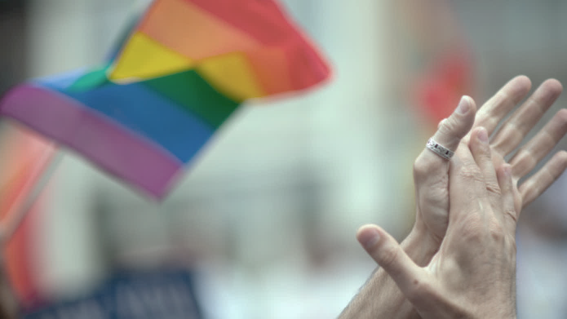
SEMINAR
Explore and discuss the array of communications channels, content and curation available.
COMMUNICATION
Review leadership models, expectations and how to manage up and down through the myriad of corporate politics and diverse personalities.
LEADERSHIP
Discuss and determine your current and potential resources for ERG development and delivery.
RESOURCES
Measuring success, both quantitative and qualitative, and being able to translates results into impactful narrative and future opportunity.
RESULTS
EXTRAS
FREE eBook Gayrilla Leadership
FREE Digital ERG Success Toolkit
LGBTA Leadership Lessons from Behind the Corporate Lines
By: Justin R. Knepper – COMING CHRISTMAS DAY
Interactive version of all the material covered in the seminar for easy reference.

Slide 5
Leaders Speak Out In Support…
EVP - Garen

Slide 6
What We Did To Engage…
Senior Management Presentation
TELL US LGBTA Survey
Film Screening and Fundraiser
Kicking them out of the Corporate Closet, this event presented the opportunity for OUTWest leadership to speak to a group of senior executives about who we are, what we do and why it is different from all other ERG’s.
Uncovering the good, the bad and the ugly, this first survey provided a wake up call of the reality of what our employees thought and opinions on what we should be doing (in support of our LGBTA employees.)
Bringing together the community for education, celebration and fundraising at this unique and successful film screening event of a new documentary about the AIDS Quilt, that included the Producer/Director of the film, benefiting a local AIDS organization.

Slide 7
ERG PROCESS CHART*
PHASE 1: Assess Your Organization’s ERG Readiness (1-3 months) |  | PHASE 2: Make and Sell Your ERG Business Case (1-2 months) |  | PHASE 3: Determine Governance & Member Structure (1-2 months) |  | PHASE 4: Launch Your ERG (1-2 months) |  | PHASE 5: Win Support, Attract Members & Build Teams (1-2 months) |  | PHASE 6: Generate Value (Ongoing) |  | PHASE 7: Measure Effectiveness (Ongoing)
Perform an Organizational Assessment |  | Build Your Business Case |  | Decide on Your ERG Philosophy |  | Write a Communication Plan |  | Win Leadership Support |  | Establish a Global Presence |  | Determine What Will Be Measured
Align the Business Case |  | Sell Your Business Case to Key Stakeholders |  | Determine Your ERG Governance |  | Prepare a Handbook |  | Determine the Right ERG Leader |  | Cultivate a Destination for Leaders |  | Gain Understanding of Measurement
Link ERG Contribution in D&I Strategy |  |  |  | Shape Your Membership Structure |  | Invite Employees to Submit an Application to Start and ERG |  | Drive Membership Growth |  | Drive Commerce |  | Consider the 4C ERG Assessment Model
 |  |  |  |  |  | Have a Launch Event
*SOURCE: Network and Affinity Leadership Handbook

Slide 8
Communication essentials
Channels & Content
Mission & Vision
Relevance & Reflection
Online vs. Live vs. Print-on-Demand
Static vs. Fresh
Formal vs. Informal
Brevity is Key
Focus for the Future
Correlation of Business Objectives
Relevance to the audience and community
Topical for current events impacting the community
Politically informative but not positional
Personally connects with the audience
Engages to ignite action

Slide 9
Mission & Vision Defined
Mission Statement
A statement of the purpose of a company, organization or person; its reason for existing; a written declaration of an organization's core purpose and focus that normally remains unchanged over time.
Vision Statement
Defines the optimal desired future state - the mental picture - of what an organization wants to achieve over time, written succinctly in an inspirational manner that makes it easy for all employees to repeat it at any given time.
Simply put, the MISSION is the “what” and “why”, and the VISION is the “dream” and “inspiration”.
EXAMPLE
OUTWest Mission: Engage our LGBTA (Lesbian, Gay, Bisexual, Transgender, and Allies) employees in meaningful and relevant activities and information sharing platforms that promotes equality through education and participation.
OUTWest Vision: To recognize, celebrate, and leverage our internal and external LGBTA network in order to achieve Bank of the West’s diversity and inclusion objectives.​

Slide 10
Who & How
Building Your Mission & Vision Statements
Developing (or refining) your Mission and Vision statements is both an art and science. Below is a high-level framework you can use to develop your statements that will have impact for your target audience.
WHO
HOW
Establish who is involved
Brainstorm without limitations
Review the questions to the left
Draft options to “sleep on”
Regroup and refine
Ensure alignment with D&I mission/vision
ERG Leaders
Executive Sponsors
Diversity & Inclusion Council
ERG Members

Slide 11
Questions To Answer
Why does your ERG exist?
Who is your target audience?
What does your ERG do?
What value to you provide?
What roles does your ERG play?
Mission
Where do we see ourselves in five years, and how are we going to get there?
What problems do we hope to solve in the next few years?
What do we hope to achieve?
Does it describe what you do?
Has it gone beyond simple? Is it over-engineered?
Is it easy to recite/explain?
Can you explain it to your friend that DOESN’T work in your industry?
Did you sleep on it?
Vision

Slide 12
Content Is King
Relevant and timely content delivered via multiple channels is key to a successful communications strategy. Communications can be defined in many ways and delivered in a variety of formats, thus consistency in your overall messaging and maximization of communication channels will enable increased engagement of employees.

Slide 13
Channel Choices
Using one, or all, of these communications channels depends on the message and initiative. Usually, any message will utilize multiple channels (at least 2) to maximize visibility.
ONLINE | LIVE | PRINT
Email Intranet Site eNewsletter WebEx/Webcasts eLearning | Teleconference In-Person Meetings WebEx/Webcasts Mixers Forums/Panels | Newsletters Flyers Resource Guides

Slide 14
Static Versus Fresh
Static
Fresh
Lists: Sharing LGBTA listings of internal and external resource sites.
Statements/Facts: Placing key messages, such as Mission/Vision Statements, and relevant group/community data.
Contacts: Providing contact information and resources to engage employees for further dialogue and participation ensure authenticity and personalization of the group.
Stories: Highlights and in-depth articles about recent events (internal and external) that align with your overall mission/vision.
Series: Modules/series of educational content (via email, articles, WebEx, in-person, etc.) that are relevant and current, aligning with LGBTA topics/issues.
Panels/Forums: Engaging via live events stimulates exploratory conversations and feedback loops essential to authentic engagement.

Slide 15
Formal Versus Informal
FORMAL
INFORMAL
Intranet articles and presentations (by ERG Leaders) that provide reporting, initiative updates and/or recap of accomplishments.
Email distribution to ERG Members and/or ERG summits/workshops that seeks to engage and inform members at an individual level.

Slide 16
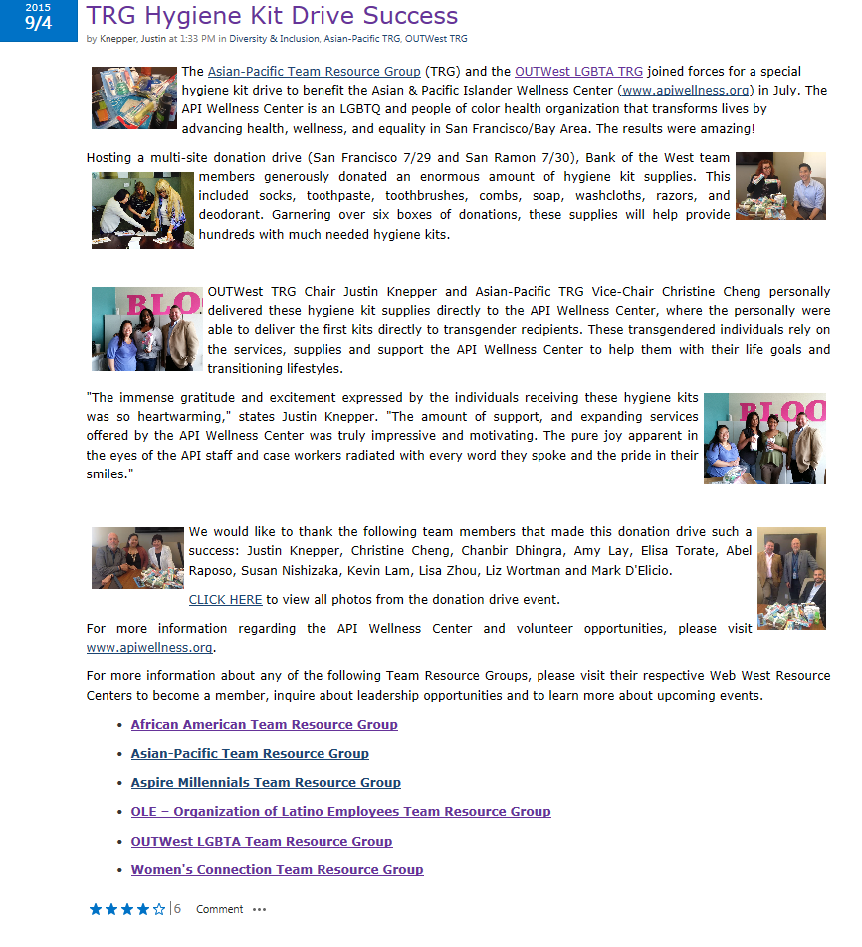
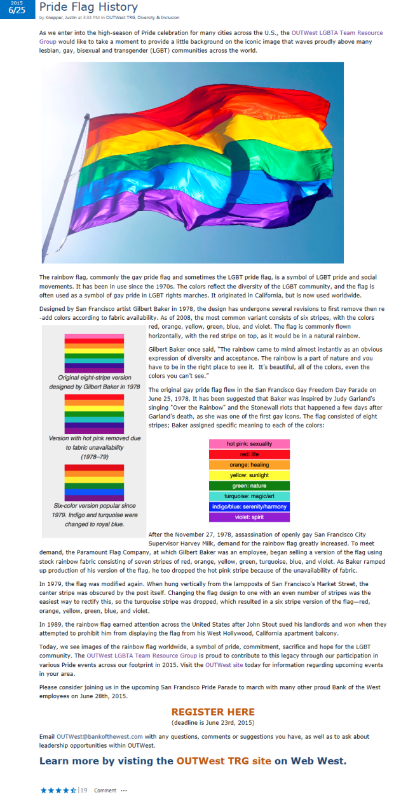
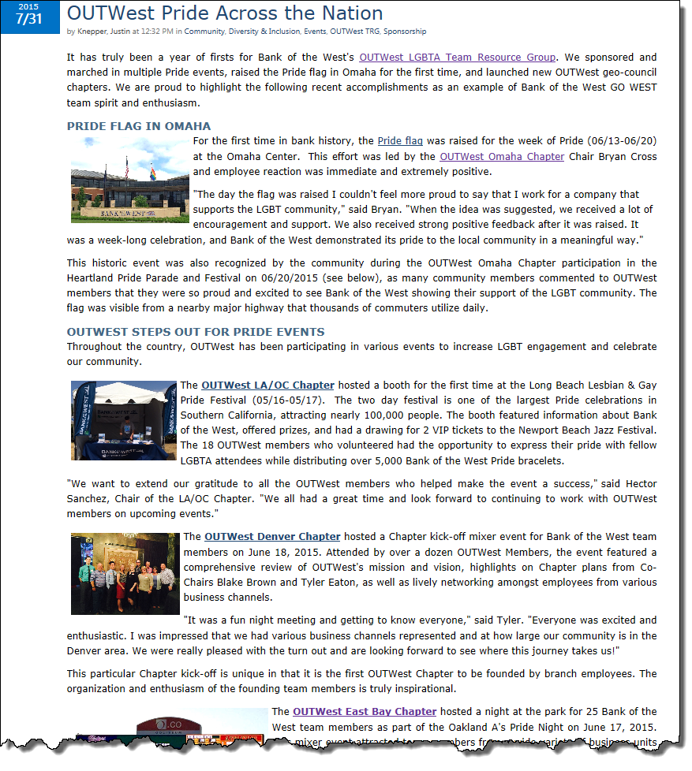
Share Your Story
Community Engagement
ERG Partnership
Employee Engagement
Community Engagement
Employee Education
Employee Engagement

Slide 17
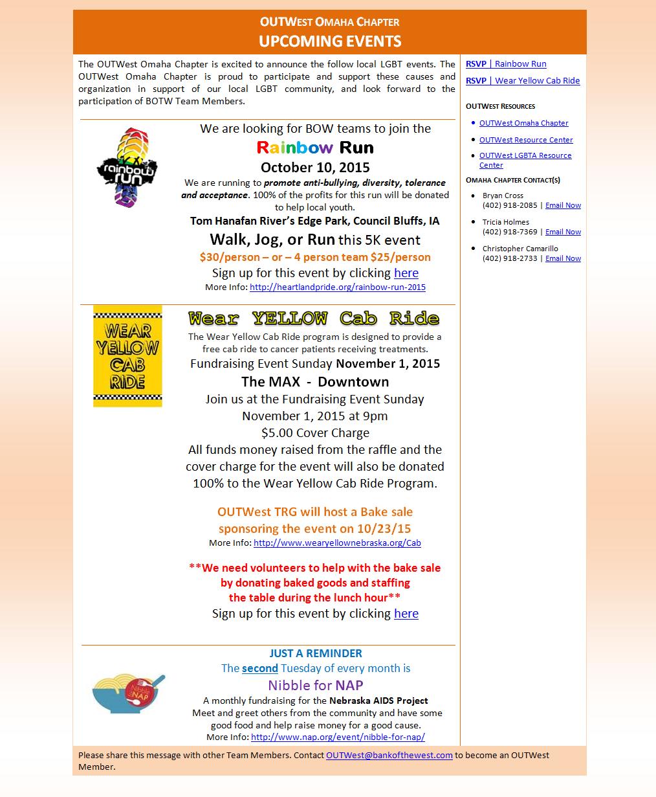
Actionable Emails
1
ACTION EMAIL
1
MAIN SECTION: Includes summary section to provide overall message/instructions.
2
2
SIDE BAR: Includes action links, key resources/references, and contacts.
FOOTER: Consistent reference to main OUTWest email for questions and membership registration. Included in all communications
3
3

Slide 18
Call To Action Communications
Action items/links for responding prominently displayed at top for ease of reference and access. Programmed to either go to site for registration or generates email with automatic subject line.

Slide 19
Informational Emails
INFO EMAIL
Same sections, but SIDE BAR is focused on general resource references and contacts.

Slide 20
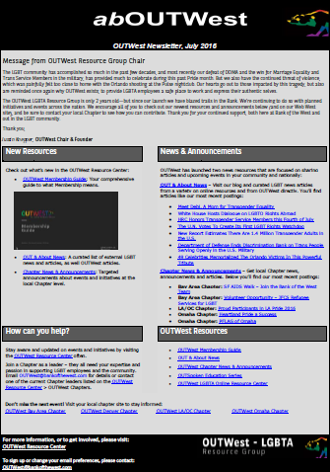
Keep Them Engaged
Executive Summary / Message from Leadership
New Resources / Updates
News / Announcements
“How can you help?” – CALL TO ACTION
Resources
Chapter Listings
Contact Information

Slide 21
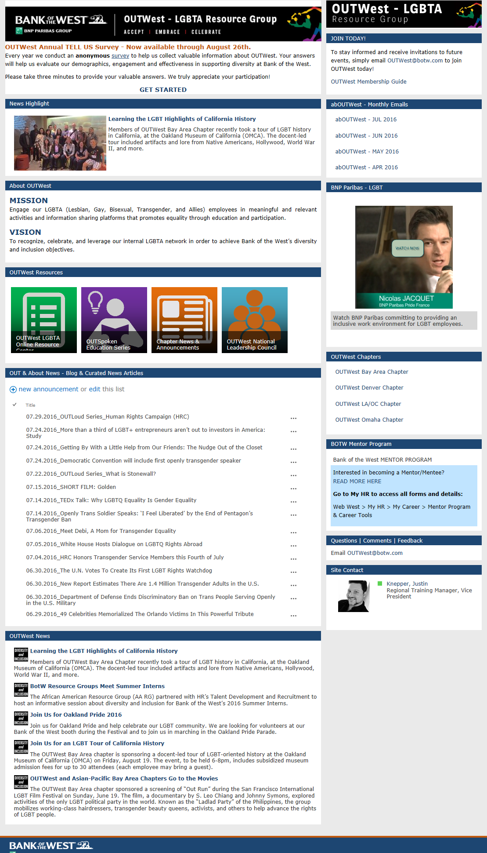
Centralize Information
Membership/Subscriber instructions prominent and easy to access
Clear placement of monthly email newsletter
Executive messaging positioned as priority item
Mission and Vision statement prominently displayed
Iconic and easy to scan for key resources and messages
BLOG STYLE
News feeds/stories integrated throughout the site
Easy access to local/chapter information to promote engagement
CORPORATE STYLE

Slide 22
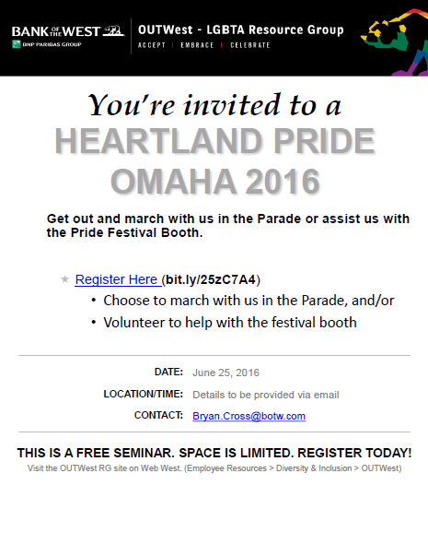
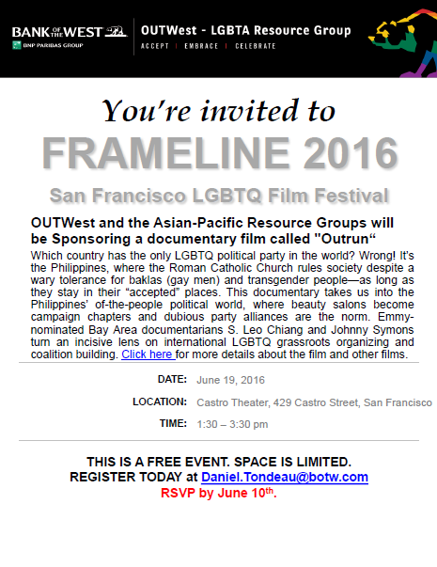
Branded Flyers
ERG FLYERS
Printed flyers for posting and email distribution to encourage registration and ease of accessing event/group information.
Aligned with organizational branding, presents a professional quality and employee familiarity.

Slide 23
Finding The Muse
Relevance & Reflection
Relevance to the audience and community
Topical for current events within/impacting the community
Politically informative but not positional
Personally connects with the audience
Engages to ignite action
Finding the Muse
Connecting with the target audience relies on the type of messages you create, but also how you contextualize them to resonate with the reader. Planning your topics that resonate is critical in order to provide an authentic voice and igniting action with your ERG members and community.

Slide 24
Topics Tour De Force
Topics Tour
Politically Correct
Getting Personal
Fuel Action
LGBT Education
LGBT Community Resources
LGBT Experts/Speakers
Workplace Rights
Volunteer Opportunities
Leadership Opportunities
Current LGBT Legal Highlights
Recent Political Wins
Resources for LGBT Political Education
Company stance on LGBT issues
LGBT Employee Bios/Interviews
LGBT Volunteer Event Recap
Local Heroes/Leaders
Employee LGBT Surveys
Call for Leaders
Call for Ideas
Event Recommendations
Invite Community Stories
Reference ERG Contacts & Resources

Slide 25
Group Exercise | Content Creation Carousel
EDUCATION
EQUALITY
EVENTS
ENGAGE
Break out into groups
Brainstorm ideas
Mix ideas
Match channels
Map story
OUTSIDE
NEVER say NO
THINK
the BOX

Slide 26
Leadership Essentials
Inspiration & Perspiration
Roles & Responsibilities
Clarity & Collaboration
Motivation for Leaders vs. Audience
Accountability is Key
Tell The Story – Over and Over and Over
Messaging | Timing | Objectives
Scope vs. Capacity
Be Clear & Cheer
Ask, Don’t Tell
Simplify Upstream, Granulate Downstream

Slide 27
Motivation
Leaders
Driven by exposure, skill building and sense of pride. Need to have dedication to go “above and beyond” for the group, while maintaining quality job performance. Understands the balance between their “day job” and their “gay job.”
Audience (Members)
Driven by relevance and inspiration. Want to feel a part of the global and local initiatives, and know that their voice is heard. Also looking to connect with the community and/or clients.

Slide 28
Accountability
There are multiple ways to establish and drive accountability of leaders.
Ensure acknowledgement to Senior Management of work completed
Provide exposure/access to Senior Management
Leverage their specific skill-set and target their passion
Establish timelines, be flexible while ensuring contingency planning (for critical deliverables)
Assign mentors (for new Leaders) to share best practices and experience in managing ERG tasks and responsibilities
Be transparent in time commitments required (meetings, off-site events, follow-up activities, etc.)

Slide 29
Tell The Story
Sharing accomplishments of the group and individuals.
Create relevance with current events outside the organization.
Align the activities and Mission/Vision of the group.
Consistent messaging and share the stories via multiple channels.

Slide 30
Roles & Responsibilities
 | Executive Sponsor(s) | National Leadership Council | Local Chapters/Councils
Messaging | Short and clear Easy to access and review | Aligned with D&I Mission Focused on larger movement | Targeted to local audience Actionable and inspired
Timing | Monthly / Quarterly Be flexible and accessible | Monthly As-needed for subcommittee work | Monthly As-needed for subcommittee work
Objectives | Connect with Senior Management Provide access to resources | Create national initiatives and plan Maintain focus and momentum | Focus on local events Engage employees 1-on-1
Scope | Advisor | Driver | Facilitator
Capacity | Limited | Expansive and Flexible | Targeted and Flexible

Slide 31
Clarity & Collaboration
BE CLEAR & CHEER
Be aware of how communication to various levels of leadership is formulated.
Include summaries and thoughtful layout of information.
Remain positive with all messaging, even when delivering non-positive messages.
ASK, DON’T TELL
Respect others’ time and interests.
If the person has specific experience/expertise, this would validate why they are a good person for the deliverable.
Remember, these are corporate “volunteers” that are not directly accountable to the ERG, therefore awareness and sensitivity in addressing participation issues should be managed with empathy and acknowledgement of other “job” responsibilities that may have impeded leaders from providing the support they wanted to contribute.

Slide 32
Information Flow
Depending on the direction of the communication, the details provided will change.
DOWN STREAM
GRANULATE
More details
Message Recap
Headers
Visually engaging
Less details
Executive Summary
Bulleted
Visually engaging
SIMPLIFY
UP STREAM

Slide 33
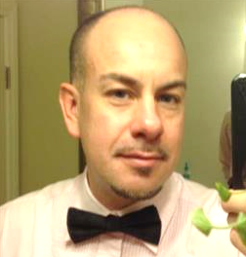
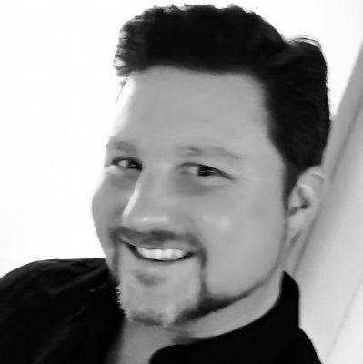
Panel Discussion | Building From the Ground Up
Meet today’s Panelists
Bryan Cross
Panelist
Hector Sanchez
Panelist
Abel Raposo
Panelist
Justin Knepper
Moderator
Contact Center Regional Mgr, VP
OUTWest Omaha Chapter Chair & Founder
Omaha, NE
Past Roles
Transaction Processing Manager
Regional Business Support Manager (Bank of America)
Consumer Banking Unit Manager (Bank of America)
Technology Manager (Bank of America)
Operations Supervisor, AVP
OUTWest NLC Education & Resource Mgr
Los Angeles, CA
Past Roles
OUTWest LA/OC Chapter Chair & Founder
Fiserv (volunteer on their PEP+ Steering Committee)
Treasury Management Implementation Support Officer (City National Bank)
ACH Operations (City National Bank)
ACH Supervisory (Zions Bank)
National Sales Support Consultant, AVP
OUTWest NLC Program Mgr
San Francisco, CA
Past Roles
OUTWest Bay Area Chapter Chair & Founder
Customer Service Manager, BOTW
Operations Manager, Citibank
Small Business Program Manager, VP
OUTWest NLC Founder & Chair
San Francisco, CA
Past Roles
Mass Affluent Program Manager (Bank of the West)
RSB Division Administration Mgr & Go West Business Academy Founder (Bank of the West)
Small Business Program Manager (Union Bank)
UB PROUD ERG Founder & Chair (Union Bank)

Slide 34
THAT’S LUNCH!

Slide 35
WELCOME BACK!
Lets meet the…
SUPER
GAYS

Slide 36
Group Exercise | TEDTalk Time OUT
Filmed May 2015 at TEDWomen 2015
Jenni Chang and Lisa Dazols: This is what LGBT life is like around the world
Sample Questions:
How does multicultural aspects referenced in this video align with your current ERGs?
Do you know any Super Gays in your life?
What did they do to stand out? Make a difference?
How can we make more Super Gays?
Gay rights – must first be won in the hearts and minds of the people, then the courts.
Gender identification and culture – how can we bridge the gaps?
Being disowned by family/society (i.e. Kenya) – how do we combat this? Foster inclusion and engage resources?
Insights to Share:
Equality is NOT a Western invention.
Countries influencing countries – Communities influencing communities – Coworkers influencing coworkers.
A love story – of loving ourselves, our identities, and our neighbors.
Use a TEDTalk to engage in discussions with employees on any topic.
This provides valuable insights, fun interactions, and it’s affordable…because it is FREE!

Slide 37
Results
Engagement
Revenue
Relevance
Membership
Volunteering
Attendance
ROI – Customers
ROE – Employees
ROR – Career
Connecting with Community
Connecting with Employees
Connecting with Leaders

Slide 38
Engagement
MEMBERSHIP | VOLUNTEERING | ATTENDANCE
Email Subscribers Followers – JIVE, Yammer, etc. Likes/Ratings – Intranet sites | Hours Contributed Number of Organizations Skills Contributed | Total Employees Attending Total People Attending Total Executives Attending

Slide 39
Revenue
ROI
ROE
ROR
Return On Investment | Return On Equality | Return On Recognition
New Relationships Products Sold Deposits Generated Funds Raised Hours Volunteered | Policies Updated/Added Seminars Conducted Resources Accessed Safe Space Commitments Self-ID Totals | Career Connections/Networking Mentoring Executive Recognition Performance Review Award Programs

Slide 40
Relevance
Connecting With Community | Connecting With Employees | Connecting with Leaders
Event Reviews Sponsorships Committed Testimonials Media Coverage | Interviews (for articles) Testimonials Mentorships Surveys | Networking Events Interviews Reverse Mentorships Event Engagement (attendance)

Slide 41
Resource Essentials
Online vs. Live
Business Partners (internal)
Knowledge Experts (external)
Accessibility
Interactivity
Feedback Channels
Communications & Marketing
Sponsorships & Philanthropy
Peer ERG Leaders
Business Unit Leaders/Management
Who are your experts? Leveraging existing experts.
Leveraging existing external experts/resources
Ensuring professionalism and accuracy
Shelf Life QC

Slide 42
Online vs. Live
 | Intranet Site | Intranet Articles | Emails | Meetings | Surveys | Events
ACCESSIBILITY | High | High | Medium | Low | High | Medium
INTERACTIVITY | Medium | Low | Medium | High | Low | High
FEEDBACK CHANNELS | Medium | Low | High | High | High | High

Slide 43
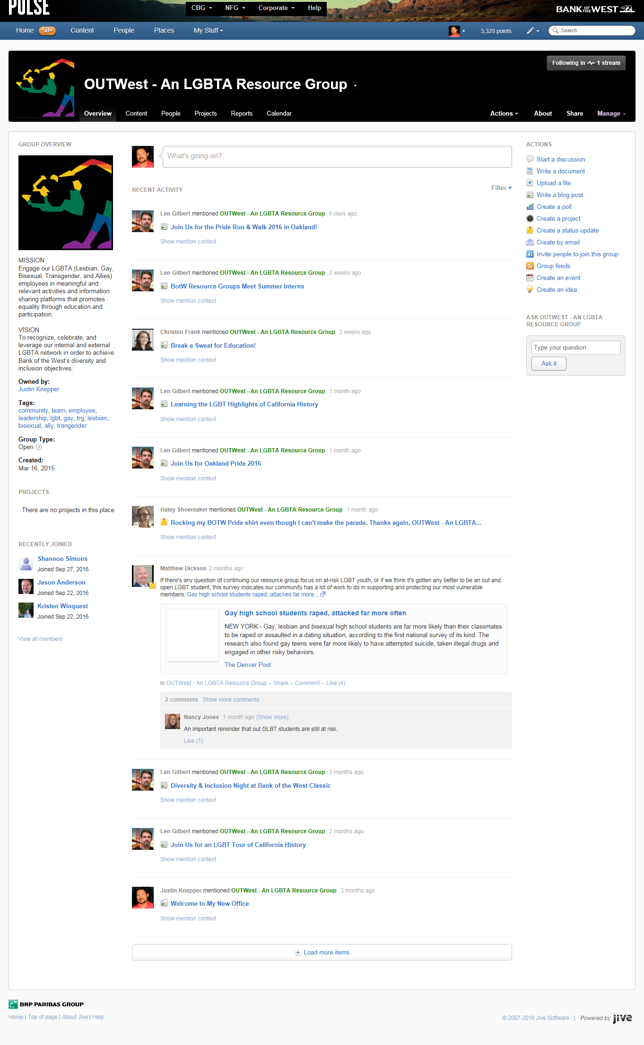
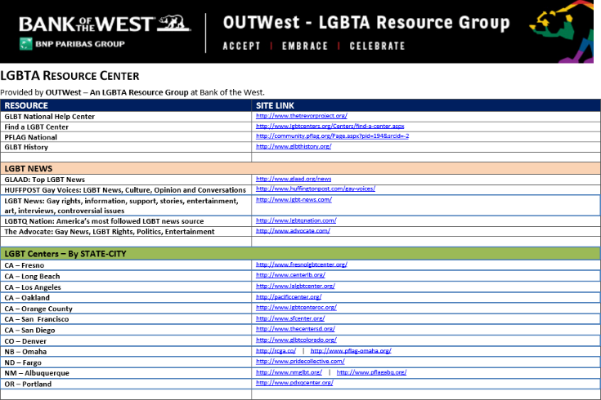
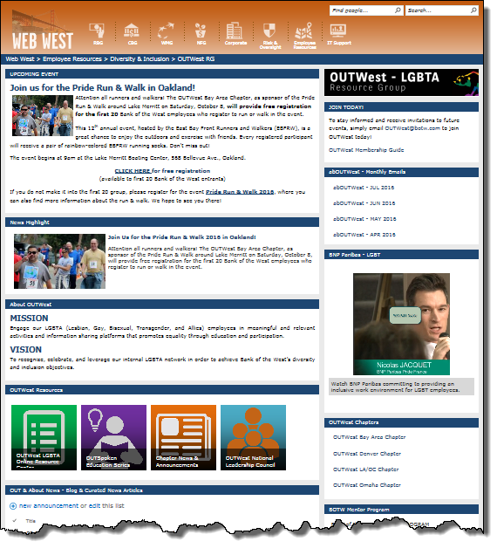
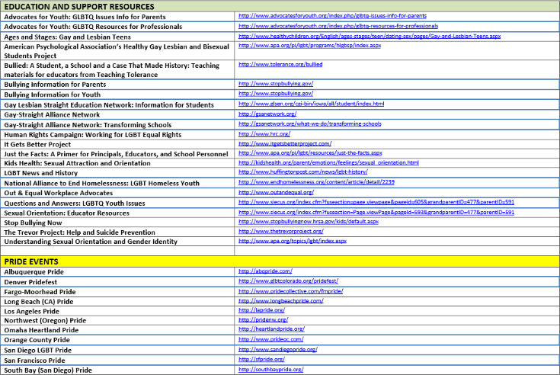
Online

Slide 44
Surveys
2014 Survey
2016 Survey
Available to all employees.
Available to all Members and Site Visitors.
LGBTA Identification | Percent
Ally (Straight) | 61.5%
Gay | 22.7%
Bisexual | 6.6%
Lesbian | 5.2%
Other | 3.5%
Transgender | 0.4%
Sexual Orientation | Percent
Ally (Straight) | 43.8%
Gay | 36.0%
Lesbian | 7.0%
Bisexual | 5.6%
Pansexual | 3.5%
Other | 2.1%
Rather Not Answer | 2.1%
Gender Identification | Percent
Cisgender | 97.2%
Transgender | 1.4%
Rather Not Answer | 1.4%
Relationship Status (LGBTPQ)
Single/Dating | 38.5%
Married | 25.6%
Committed Relationship | 20.5%
Domestic Partnership | 10.3%
Other | 3.9%
Rather Not Say | 1.3%
Why did you become an Ally?
How “OUT” are you? | Percent
Entirely; I am "out" with family, friends and co-workers. | 66.7%
Reserved; I am "out" with family and friends, more reserved at work. If I was asked, I would respond truthfully. | 24.4%
Corporate-closeted; I am "out" in my personal life, not at work. | 3.9%
I am not "out" to anyone | 3.9%
I'd rather not answer | 1.3%
FAMILY
35.5%
CO-WORKER
64.5%
FRIEND
90.3%

Slide 45
Business Partners (internal)
Communications & Marketing | Sponsorships & Philanthropy
Peer ERG Leaders | Business Unit Leaders/Management
Corporate Communications can be a strong ally in getting your message out to the employees (even into the media).
What is the communication platform available?
Can they help write/develop content?
Marketing is an important component to ensure branding adherence (especially for external events).
Can they provide assets (logos, banners, etc.)?
Can your ERG inform the company marketing strategy?
Community Affairs (or the equivalent) is great resource to find appropriate volunteer opportunities and non-profit organizations to partner with.
Is there a volunteer tracking platform?
Are there any Corporate Grants/Sponsorships to align with?
Any connections with key boards/community centers?
Combining resources with peer ERGs can result in bigger events and increased impact.
Identify common causes or communities (i.e. API Wellness Center of SF) that provides partnership opportunities.
Learn from experience ERG leaders.
Powerful partners (and advocates) may already exist within your organization.
Engage them to access their employees (emails, meetings, etc.)
Invite them to be guest speakers (or special attendees) to your events.
Leverage their influence to build your network and share your mission.

Slide 46
Knowledge Resources (external)
Who are your experts? Leveraging existing experts.
Current community partners and organizations
Known speakers and movement leaders
Academic professionals
Personally known (through ERG network – Family, friends, colleagues)
Ensuring professionalism and accuracy.
Cross-check your resources and references
Validate resource/expert with known channel/authority
Conduct review/interview of material/person(s) before fully engaging
Shelf Life QC.
Determine shelf-life of content
Schedule review of material
Utilize multiple reviewers/approvers

Slide 47
Your Roadmap
Take 5 minutes
List the top ACTIONABLE items you can do immediately
List the top FUTURE (next 2 years+) items you can do
Top challenges
Biggest insights for the day

Slide 48
Research & References
Building Your Company’s Vision (Harvard Business Review | 1996)
By James C. Collins and Jerry I. Porras
https://hbr.org/1996/09/building-your-companys-vision&cm_sp=Article-_-Links-_-Top%20of%20Page%20Recirculation
Vision and Mission – What’s the difference and why does it matter? (Psychology Today | 2010)
By Jennell Evens
https://www.psychologytoday.com/blog/smartwork/201004/vision-and-mission-whats-the-difference-and-why-does-it-matter
How to Write Your Mission Statement (Entrepreneur | 2003)
By N/A
http://www.entrepreneur.com/article/65230
How to Establish a Vision Statement Employees Will Get Behind (Entrepreneur | 2015)
By Andre Lavoie
http://www.entrepreneur.com/article/245249
Your Company Vision: If It's Complicated, It Shouldn't Be (Forbes | 2013)
By Shaun Spearmon
http://www.forbes.com/sites/johnkotter/2013/10/14/the-reason-most-company-vision-statements-arent-effective/
How To Write a Good Vision Statement (Executive Strategy – Cascade Blog| 2014)
By Tom Wright
https://www.executestrategy.net/blog/write-good-vision-statement/
Network and Affinity Leadership Handbook – The Definitive Guide for Forming, Launching and Engaging Employee Resource Groups
By Mesha Mott and Andres T. Tapia
www.DiversityBestPractices.com

