Slide 1
Unconscious Bias- HP Sections for Out & Equal
Out & Equal Global Conference- Orlando October 2016

Slide 2
Diversity and inclusion: importance
Diversity
Inclusion
Best in class companies for diversity outperform their peers by 26% in the S&P markets*
Such companies foster environments where employees are engaged in a way that unlocks their full innovative potential
Leads to better decision-making in serving customers and growing the business
* Diversity Inc., (2015) Business Study on the ROI of diversity
Notes:
You might ask why are diversity and inclusion important to a business? Well, there are several reasons.
First, it’s been shown that best-in-class companies for diversity outperform their peers by some 26% in the S&P market.
These companies also foster environment where partners are engaged in such a way that their full innovative potential can be unlocked.
And it leads to better decision making in serving our customers and in growing the business.
************************************************
OBJECTIVE: outline the relationship to this session and inclusion and diversity
KEY POINTS:
Understand why Inclusion and Diversity is important at HP
Inclusion and diversity are important indicators to successful businesses
SAY:
Here is why we practice inclusion and diversity at HP – read each of the four quadrants.

Slide 3
Diversity and inclusion: impact on market growth
45% more likely to improve market share
Embracing D&I
Creates a speak-up culture
Unlocks “points of pain” insight
Unleashes innovation
70% more likely to capture a new market
Center for Talent Innovation, 2013
Notes:
OBJECTIVE – speak up cultures drive innovation and results
KEY POINTS:
Leaders have to embrace and understand diversity
Creating a speak up culture drives growth for an organization
SAY:
Center for Talent Innovation conducted research with over 800 companies on how D&I drives innovation. (Read the arrows across the slide.)
In order to get the benefits of diversity and inclusion we need a culture where people can speak up and participate. This ability to speak up can be hampered if we have biases about partners and create “challenges” to their participation.

Slide 4
Diversity and inclusion: proven success
GROWTH
diversity & inclusion
innovation
Notes:
OBJECTIVE: demonstrate that other companies have practiced diversity to drive growth.
KEY POINTS:
Diversity, inclusion and innovation is not new
Other companies have found success using the same process
SAY:
You might wonder how we know that diversity and inclusion can influence business results. The companies we see here are probably familiar to you. What they have done is find ways to leverage diversity and inclusion to do just that. How, you ask?
Kingsford engaged with their Latino employee resource group HOLA to market and increase sales to that demographic
IKEA started promoting its furniture not only to people in small homes who were attempting to maximize space, but also to families – consider the evolution of their ads for their products
Campbell’s leveraged their diverse workforce to produce “good tasting” soups that are heart healthy
Finally, Doritos added different flavors to their product line to appeal to the palates of a changing consumer market
These companies recognized the importance of getting more voices around the table, and they could effectively respond to the demands of a diverse consumer base. Diversity and inclusion in the workplace fosters innovation, which in turn drives growth.

Slide 5
Bias: definition
Bias
A tendency or inclination that results in judgment without question
Unconscious Bias
Mental associations without awareness, intention, control
vs

Slide 6
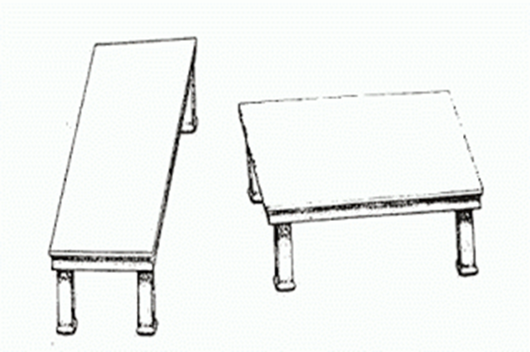
Mindbug: definition
Mindbug
An ingrained habit of thought that leads to errors in how we perceive, remember, reason and make decisions
From Blindspot: Hidden Biases of Good People (Banaji & Greenwald, 2013)
Notes:
OBJECTIVE: To relate biases to mindbugs.
KEY POINTS:
Give another name to how biases impact us
Understand that the biases impact how we perceive information and make decisions.
SAY:
Read the slide.
Important point to remember is that biases are like “mind bugs.” They can impact the way we make decisions based on ingrained habits of thought.

Slide 7
Selective attention
11 million pieces of information
What our brain absorbs is based on:
Perceptions – what we think is correct
Interpretations – what we make of what we see
Preferences – what we like
Selective attention – what we focus on
40-50 pieces absorbed
Notes:
OBJECTIVE: The brain filters what it takes in for efficiency and effectiveness. Much of what we take in based on past experiences, beliefs, and perception
KEY POINTS
Selective attention can cause us to miss information that is right in front of you.
The key is to build your awareness of what you pay attention to
SAY:
Everyday the brain can be exposed to 11 million pieces of information and we have the capacity to absorb on 40 – 50 pieces.
Much of what we absorb is based on our perceptions – what we think is correct; our interpretations – what we make of what we see; our preferences – what we like and selective attention – what we focus on.
Give a few examples:
Have you ever been in situation walking down a street of thousand of people and you can see the one person you know?
Have you ever been in a concert or loud place and you can hear the person next to you?
Have you been in situation where you see a car or other item you like and now everywhere you look you notice it?
These are examples of selective attention. How our perceptions bring information, people, situations from our sub conscious to our conscious.
Think about the possible ways in which selective attention can impact our organization, partners, employees and customers.
Our objective is to create more inclusive environments. Organizations that leverage inclusion and diversity have strong market place performance and success.

Slide 8
Exercises
Mindbugs

Slide 9
Blind spots
* Diversity Inc., (2015) Business Study on the ROI of diversity
Notes:
OBJECTIVE: Activity to demonstrate that we all have blind spots.
KEY POINT
We all have blind spots
What happens if your blind spot effects your behavior
SAY:
Do you have a blind spot – (pass out the grids to the participants)
Hold your paper at arms length in front of you.
Place your hand over one eye.
While focusing on the plus sign slowly bring the grid closer until the other black disk disappears. If you don’t see it try it again…slowly bring the disk closer.
Be sure to stop at the point that the black disk disappears.
Did you notice that when the disc disappears that the grid is completely filled in? The mind “fills in” in the grid. What happens when the mind fills in information that is not actually there. Take a few comments
This is what can happen when we have biases that we do not recognize. The mind can “fill in” information that is not present.

Slide 10
What’s that, you say?
Exploring multi-motor perception
Notes:
OBJECTIVE: to explore multi motor perception:
KEY POINTS:
We hear with our eyes more than we realize
SAY:
I will need your cooperation during this activity.
I plan to show a short video and I want you to listen to it.
For this activity I will need to split the room in half. People on one side will watch the video. People the other half of the room will listen to video with their eyes closed. (ut a short video that takes more than 5 seconds) Ready?
Play the video. Play it a second a time to give people an opportunity a chance to hear.
Ask the group that had their eyes closed – “what did they hear?” Ask the group who had their eyes open – “what did they did hear?”
Usually the groups will hear different tones – one will hear da da da, the other will hear ba, ba, ba.
Share with them that this is a multi motor perception - that highlights what happens when the Brain receives conflicting information tends to try to make sense (anchor) in what has experienced –

Slide 11
Who gets heard and why?
We can “hear” with our eyes!
Notes:
OBJECTIVE: illustrate how we can hear with our eyes
KEY POINTS:
Sometimes our behaviors are determined by what we see over what we hear
What are the implications for a speak up culture.
SAY: Watch the video (play the video)
Ask: has this ever happened to you? Or, have you seen it happen to others?
What do you think the implications are of this occurs?
How can it impact a speak up culture?
What if others are watching this happen will this impact their ability to be open and contribute ideas?

Slide 12
Social perception: warmth and competence
Are they capable of carrying out those intentions?
(intelligent, powerful, efficacious, skilled)
warm
competent
Do I trust their intentions toward me?
(friendly, trustworthy, empathetic, kind)
Fiske, Cuddy & Glick, 2007
Notes:
OBJECTIVE: introduce the concept of social perception
KEY POINT:
Warm and competent
SAY:
Based on the research of Cuddy social perception is based on mindbugs and/or how one perceives the warmth/ comfort level of others.
Read the warmth points – consider warm to be how they feel around them. Consider threat / competition to mean do thery feel threaten around an individual
Read the Competent points…
Let’s try a short exercise to illustrate this point
Try not to spend too much time on this section.

Slide 13
Social perception: warmth and competence
Notes:
OBJECTIVE: to set up the exercise
SAY:
You will need a piece a paper for this activity. You don’t need a large piece.
I am going to show you 6 pictures. As you look at each picture, note the feelings, judgments, and reactions that emerge. Then rate on a scale of 1 to 5 – 1 being the highest – the person’s warmth and competence based on how you perceive it.
You’re not going to share this with any one – this is for your own reflection so I would encourage you to be honest with yourself.
You’ll need two columns on your sheet. One to rate warmth on a scale of 1 – 5; the other to rate competence on a scale of 1 – 5
Ready? Let’s begin.
(Show each picture for about 10 seconds. Remind the group to rate warmth and competence on a scale of 1 – 5)

Slide 14
Social perception: warmth and competence
WARMTH
COMPETENCE
Do I trust their intentions toward me? (friendly, trustworthy, empathetic, kind)
Are they capable of carrying out those intentions? (intelligent, powerful, efficacious, skillful)
Low
High
Low
High
1
2
3
4
5
1
2
3
4
5
1
1
1
2
3
4
5
2
1
2
3
4
5
2
1
2
3
4
5
1
2
3
4
5
3
3
1
2
3
4
5
1
2
3
4
5
4
4
5
1
2
3
4
5
5
1
2
3
4
5
1
2
3
4
5
1
2
3
4
5
6
6
Notes:
OBJECTIVE: introduce the concept of social perception
KEY POINT:
Warm and competent
SAY:
Based on the research of Cuddy social perception is based on mindbugs and/or how one perceives the warmth/ comfort level of others.
Read the warmth points – consider warm to be how they feel around them. Consider threat / competition to mean do thery feel threaten around an individual
Read the Competent points…
Let’s try a short exercise to illustrate this point
Try not to spend too much time on this section.

Slide 15
Social perception: Person 1
Notes:
SAY:
On scale of 1 -5 how warm?
On a scale of 1- 5 how competent?

Slide 16
Social perception: Person 2
Notes:
SAY:
On scale of 1 -5 how warm?
On a scale of 1- 5 how competent?

Slide 17
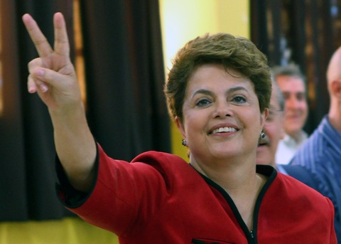
Social perception: Person 3
Notes:
SAY:
On scale of 1 -5 how warm?
On a scale of 1- 5 how competent?

Slide 18
Social perception: Person 4
Notes:
SAY:
On scale of 1 -5 how warm?
On a scale of 1- 5 how competent?

Slide 19
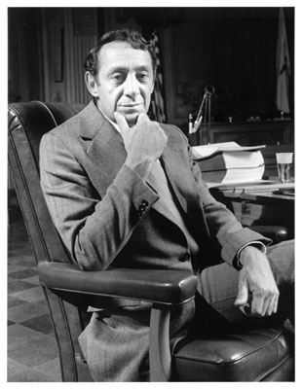
Social perception: Person 5
Notes:
SAY:
On scale of 1 -5 how warm?
On a scale of 1- 5 how competent?

Slide 20
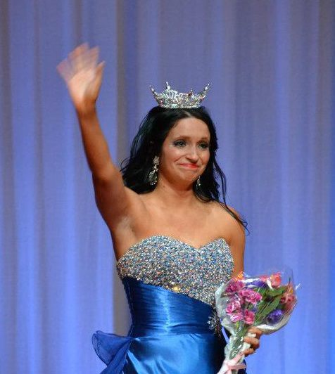
Social perception: Person 6
Notes:
SAY:
On scale of 1 -5 how warm?
On a scale of 1- 5 how competent?

Slide 21
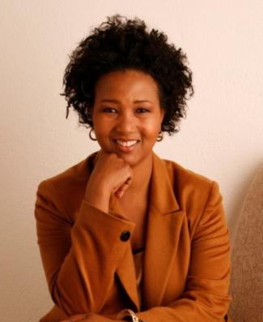
What patterns do you notice?
1. Swami Bharati Yogi
2. Dr. Mae Jamison Astronaut
3. Dilma Rousseff 1st female president of Brazil
4. Harold White NASA Physicist
5. Harvey Milk 1st publicly gay elected official
6. Alyssa Brooks PhD in Public Health
Notes:
OBJECTIVE: to explore patterns / mindbugs that impact how we perceive others.
KEY POINTS:
We all have mindbugs that impact how we perceive others
Get in touch with what triggered a reaction for you when perceiving others.
SAY:
Do you want to know who the people are? Point out each picture and ask the group if they know who each person is? Tell them as you go.
Ask, now that you know who they are does that change your perception of them?
Ask, can you identify the triggers that caused you to rate a person low or high on the warmth competence scale?
Any patterns for you? What is all women were high and the men low for example?
What did you notice? How do you feel about what you noticed? Why did your perception changed after you found out who the individuals are?
In social perception we have blind spots. Like the exercise on the grid. Blindspots are bits of knowledge about social groups.
These bits of knowledge are stored in our bias because we encounter them so frequently in our cultural environments. Once lodged in our minds, hidden biases can influence our behavior toward members of particular social groups, but we remain oblivious to their influence. That’s the impact of culture.
Most people find it unbelievable that their behavior can be guided by mental content of which they are unaware.
Picture 1 – Swami Bharati, Yogi
Picture 2 – Dr. Mae Jamison, Astronaut
Picture 3 – Dilma Rousse, 1st female President Brazil
Picture 4 – Harold White, NASA Physicist
Picture 5 – Harvey Milk, first publicly gay elected official
Picture 6 – Alyssa Brooks, Beauty pageant winner – PhD in Public Health at the University of Maryland

Slide 22
Assessing warmth and competence
Impacts of group stereotyping
High
Elderly
Mentally impaired
Physically disabled
Middle class Whites Black professionals Christians
Warmth
Poor blacks Welfare recipients Homeless Middle Eastern
Asian Jews Rich
Low
Low
Competence
Cuddy, Fiske, & Glick, 2007
High
Notes:
OBJECTIVE: Review larger study of social perception
KEY POINTS:
Explore common perceptions about individuals on the warmth / perception scale
SAY: Larger research attempted to chart the perception of how Americans might perceive others. Highlight each section of the chart.
Highlight what the researcher’s called the “Obama” effect. That fact that you have the same group listed twice however in different categories. “poor Blacks” and “Black Professionals”
Ask, why do you think peoples perception are split for that particular group?
Move the next slide

Slide 23
Stereotypes, emotions, and behaviors
Seniors, people with disabilities
Middle class, whites
Poor, poor blacks
Asian, rich
BIAS (Behaviors of Intergroup Affect & Stereotypes Map: Cuddy et al. 2007
Notes:
OBJECTIVE: Review larger study of social perception
KEY POINTS:
Explore common perceptions about individuals on the warmth / perception scale
SAY:
Based on how one might perceive a person the “feeling” for them might look like the following. Read each corner of the chart.
Pity – seniors, people with disabilities
Admiration – middle class, whites
Contempt – poor, poor blacks
Envy – Asian, rich
Toggle back and forth between the two slides.

Slide 24
Challenging biases
What would you do?
Notes:
OBJETCIVE: to see how biases can and should be challenged.
Show the video!
SAY
How can we exercise our minds to push through biases and what impact will it have on creating an inclusive workplace.

Slide 25
Exercise of the unconscious
Yellow | Blue | Orange
Black | Red | Green
Purple | Yellow | Red
Orange | Green | Black
Blue | Red | Purple
Green | Blue | Orange
Read the text
Notes:
OBJECTIVE: Transition to mind activity
Ask the group to read the colors listed on the slide. Have the group read in unison. Start with the first column and move at a good pace.
Transition to the next slide

Slide 26
Exercise of the unconscious
Yellow | Blue | Orange
Black | Red | Green
Purple | Yellow | Red
Orange | Green | Black
Blue | Red | Purple
Green | Blue | Orange
Say the color of the text
Left / Right brain conflict
Notes:
SAY:
Now this time say the color not of the word not the word. Read at the same pace as the previous. .. After a few lines laughter will fill the room. People will understand how difficult it is to complete.
Explain this is an example of a left brain right brain conflict. Them brain is attempting to carry out two task at once and its creating the confusion.

Slide 27
How many passes does the team in white make?
Seeing when you’re not seeking
Notes:
VIDEO: show the 2-part video.
SAY:
Count the number of passes the team in white make.
(Stop the video halfway through) Ask how many people saw the moonwalking bear.
Show the second half of the video.
Make the point that its hard to see what you’re not looking for.

Slide 28
Biases and the impact on business processes
Organizational Culture
Diversity Systems Map
PERFORMANCE
Mission, Vision, Values
Sales
Vendor Relationships
Coaching/ Mentoring
Benefits
Interviewing
Attrition/ Retention
Marketing/ Public
Relations
Metrics
Recruitment
Product
Management
Promotion/ Advancement/ Structure
Biz Develop/ Sales
Hiring
Software
Development
EE Resource Groups
Community Relations/
Customer
Service
Leadership & Behaviors
History
Environment
With permission Cook Ross & Associates, 2013
Notes:
OBJECTIVE: discover how biases can impact business processes
SAY:
The diversity systems map is a way to think about diversity in organizational systems.
Explain the map:
Blue circles – how we identify talent
Red circles – internal practices for developing rewarding talent
Gray circle – highlights external relationships -- notice that the yellow arrows point back to the blue circles indicating if we have positive external relationships we can feed the pipeline of talent.
The process works is if we have an inclusive organization through out our talent management system we can improve organizational performance.
Task: Divide the participants into groups 3 – 5 in each group depending on the size of your audience. After they are in groups show the next slide.
Show the next slide

Slide 29
Exercise
Action planning

Slide 30
Is there bias in our system?
In small groups select one of the areas from the Diversity Systems Map that you want to impact within your company in the next 3-6 months:
What are the potential biases that could exist within that area?
What’s at stake if nothing changes?
What tips/suggestions could be used to mitigate the impact of unconscious biases?
How could you/we be more inclusive in our approach?
Notes:
The entire exercise should last no more than 60 minutes
Instructions: (you can either assign a group a couple of categories (circles) or you can ask that they complete the entire map.
Give each group chart paper and ask that they begin the exercise:
After the group has completed the examples have them post their response on the wall.
Ask each group to read their responses
Timing
5 mins – instructions
25 min – mapping
20 min – share response with large group (assuming 4 groups)
10 mins – individual reflection

Slide 31
Reflecting on the session
What 2 or 3 items will I take away from this experience?
What did I learn about my relationship to biases during this session?
What will I personally do to mitigate bias within myself? Within my team/function?
Notes:
To be completed individually first. Then share with another participant

Slide 32
Parting exercise
How many changes occur?
Notes:
As you prepare the video: tell the group to see if they can recognize how many changes take place in the video.
After the video: say even though we spend several hours discussing blindspots…they are still hard to see!
Thank you

Slide 33
Thank you

