Slide 1
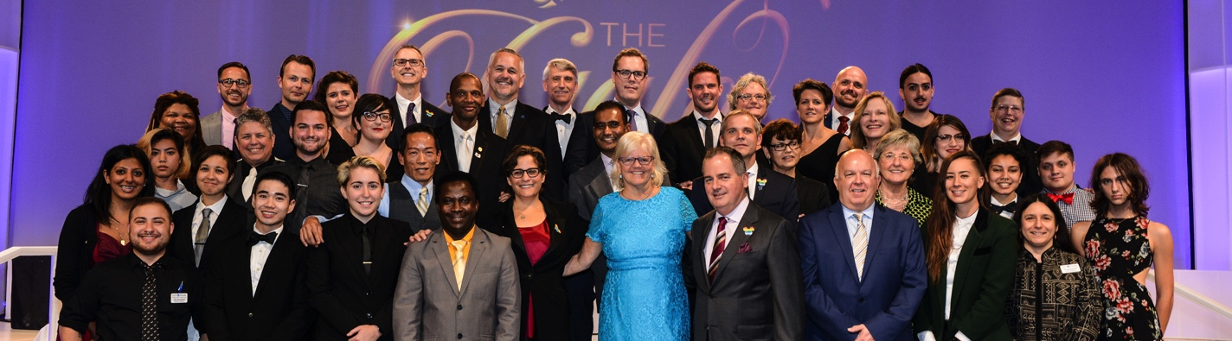
OUT & EQUAL
2016 WORKPLACE SUMMIT
TRIP REPORT

Slide 2
2016 Summit Trip Report
The purpose of the Trip Report is to provide you with an outline for constructing an account of your experience at Summit that you can use to inform management, fellow ERG members and other employees about the impact and benefits of attending the 2016 Out & Equal Workplace Summit and Leadership Day. This report contains metrics and demographics around Summit participants, information about programming and an overview of educational content.
The outline also suggests areas of participation that you might want to highlight, where applicable. Feel free to use and adapt this report as needed for your company/organization.
To activate any links included in this report, be sure to view in the Slide Show mode.

Slide 3
Leadership Day sponsored by Target
Leadership Day is a unique opportunity to develop in-depth expertise, increase professional development and enhance best practices for you and your organization. 380 individuals attended Leadership Day and participated in their choice of 8 tracks:
Public Policy
After the historic gain of same sex marriage equality in all 50 states, the achievement of full LGBT rights and equality remains at the forefront of various local, state, and federal public policy debate. From religious based discrimination to prohibitive usage of public facilities by transgender people, and more, corporate leadership has emerged as an especially key voice in the debate. This session presented on the status of these policy movements, and explored the challenges and best practices for engaging corporate and business interests in emerging LGBT concerned public policy debate.
Leadership Development for Your ERG’s Early Years
Understanding and developing the key elements of a successful framework to build and grow an Employee Resource Group (ERG) is the focus of this seminar. We explored why it is important to expect business relevance and business results from your ERG, and reviewed the key elements that should be in your strategy. Also explored beyond awareness and looked at how you build in accountability through communication, content development, internal/external resources and positioning statements that impact everyone from top executives to frontline employees. We also looked at ways to respond to common challenges from existing ERG members, executive sponsors and the general employee population, and provided a variety of templates, timelines and processes that are adaptable in any business environment.
Unconscious Bias for Leaders in the Workplace
We are the product of our environment and are shaped by its influences at an unconscious level. At times, we may not be aware of how our actions and words impact those who don’t share our experiences. This seminar explored unconscious bias and its impact on our daily lives and interpersonal behavior. We developed tools to create a more inclusive environment, increase your ERG/BRG’s impact in the workplace, and to combat biases in the workplace. This seminar also helped us understand the intersections and impact of unconscious bias with other communities, specifically bisexual, transgender and LGBT people of color.

Slide 4
Leadership Day sponsored by Target
LGBT Diversity Certification Training (Train the Trainer)
This course is designed to create a cadre of trainers who can teach on LGBT workplace inclusion, break down barriers and foster communication between LGBT employees and their co-workers. Individual employees, Human Resources and Diversity professional, and Employee/Business Resource Group leaders are certified for a period of two years to present Out & Equal materials in the workplace or their local community. This proven program of building cultural competency, business cases and developing allies, fosters alliances and breaks down myths and stereotypes to open communication and build an inclusive workplace. See the How to Get Involved Guide for more information about the Trainer’s Program.
Leadership Development for Allies and Advocates
Many workplaces are now including allies in their LGBT Employee/Business Resource Groups. This seminar developed the concept of allies, the ways in which they can impact the workplace and community, and offered best practices for leveraging allies to advance LGBT workplace equality.
Leadership in BRGs and Advanced ERG
Do you have an established ERG/BRG but are unsure of what’s next? Getting the group started was the first step-- this seminar provided best practices and opportunities to share how to make the most of your BRG/ERG, use your executive sponsor, and become fully integrated in the business case.

Slide 5
Leadership Day sponsored by Target
LGBT Recruitment and Executive Promotion
As more and more companies develop LGBT-specific recruitment strategies, employers are also seeking clear ways to retain and promote top employees. This seminar explained why recruitment, retention and promotion are a critical next step for LGBT workplace inclusion. Whether you are LGBT or ally, an ERG member or leader, HR professional or executive, this seminar can help shape your current policies and identify successful strategies.
LGBT Diversity & Inclusion Leadership in the Government Sector
Designed specifically for government employees, this seminar brought together different federal agencies to share best practices on promoting LGBT inclusion and equality at work, including strategies for securing agency- and department-level support, developing business plans, improving LGBT recruitment efforts, and strengthening special emphasis programs.
Global Leadership in LGBT Diversity & Inclusion
This seminar was designed for people who work on or are interested in the advancement of LGBT workplace equality globally. This workshop shared the results of recent worldwide surveys on LGBT equality and provided best practices for establishing ERGs internationally, as well as discussed other global LGBT workplace challenges such as travel advisories and expat assignments. This seminar provided a network of practitioners who work with LGBT global equality on a daily basis and have a fountain of ideas and experiences to share.

Slide 6
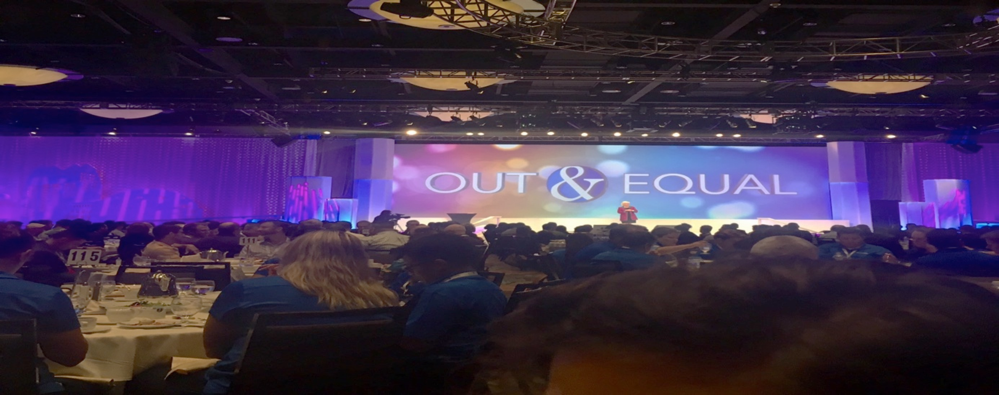
Total Attendance 4106

Slide 7
Summit Demographics

Slide 8
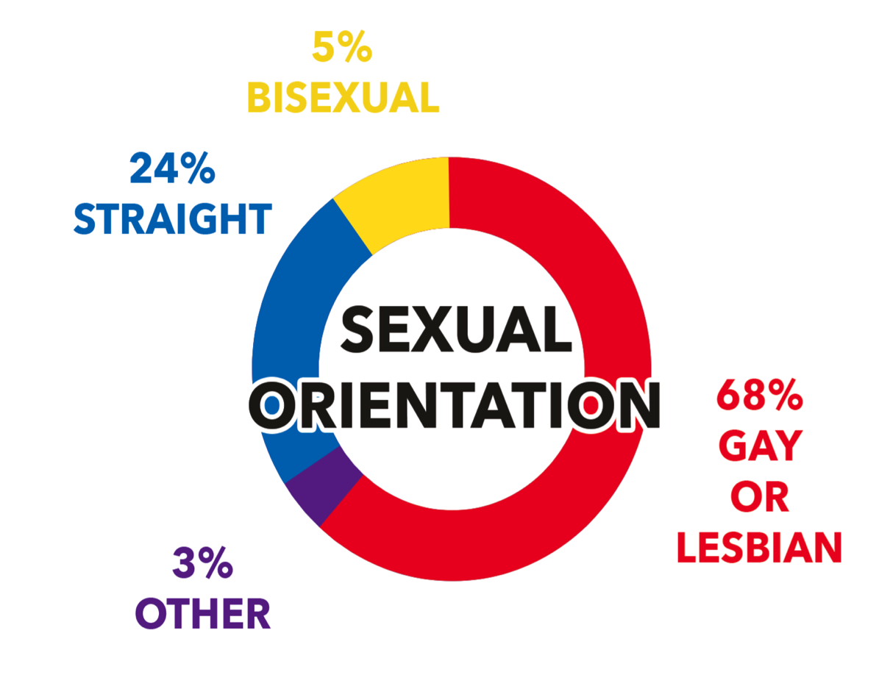
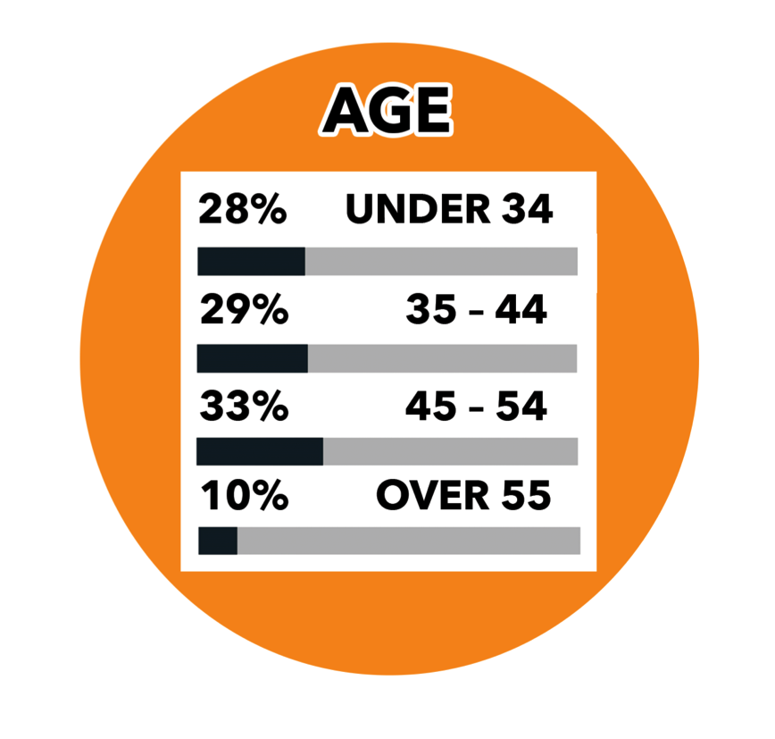
Summit Demographics

Slide 9
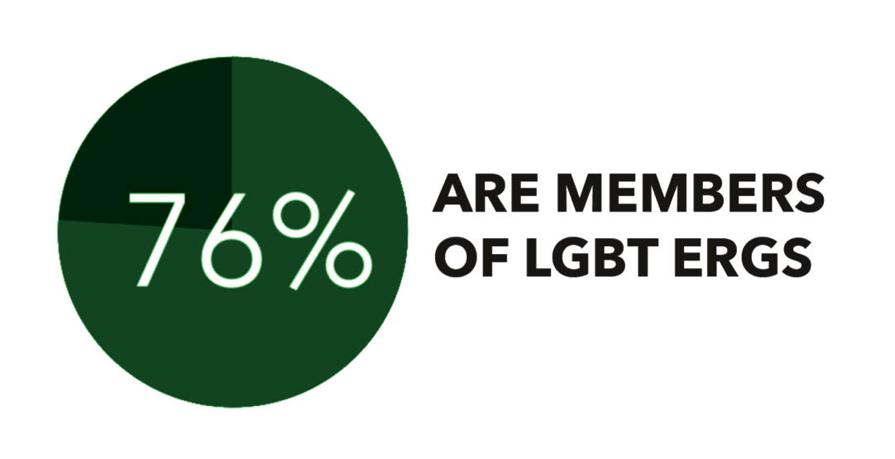
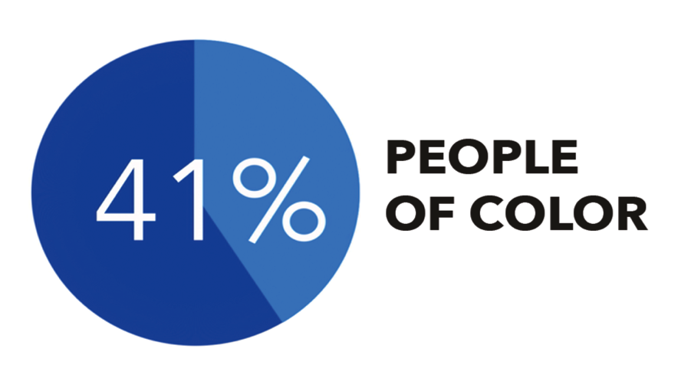

Summit Demographics

Slide 10
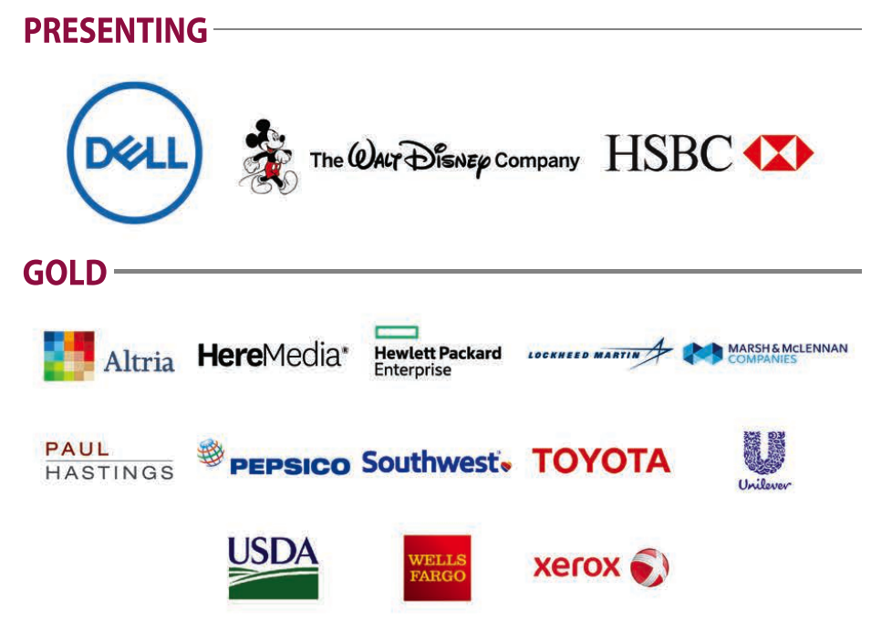
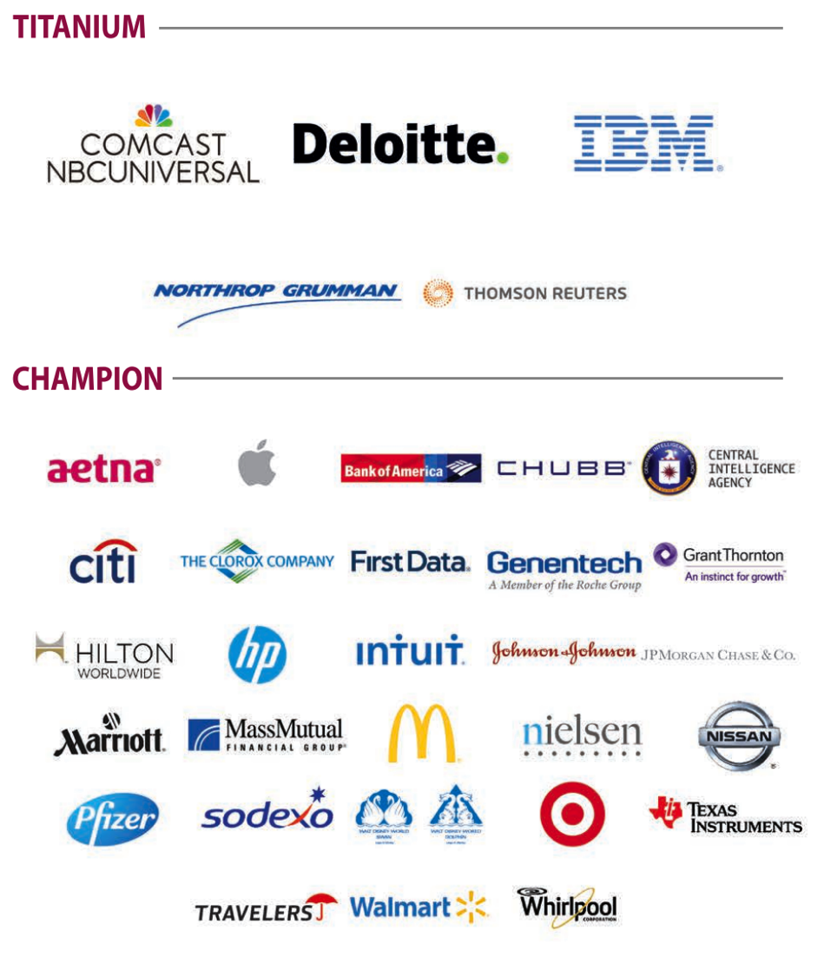
2016 WORKPLACE SUMMIT SPONSORS

Slide 11
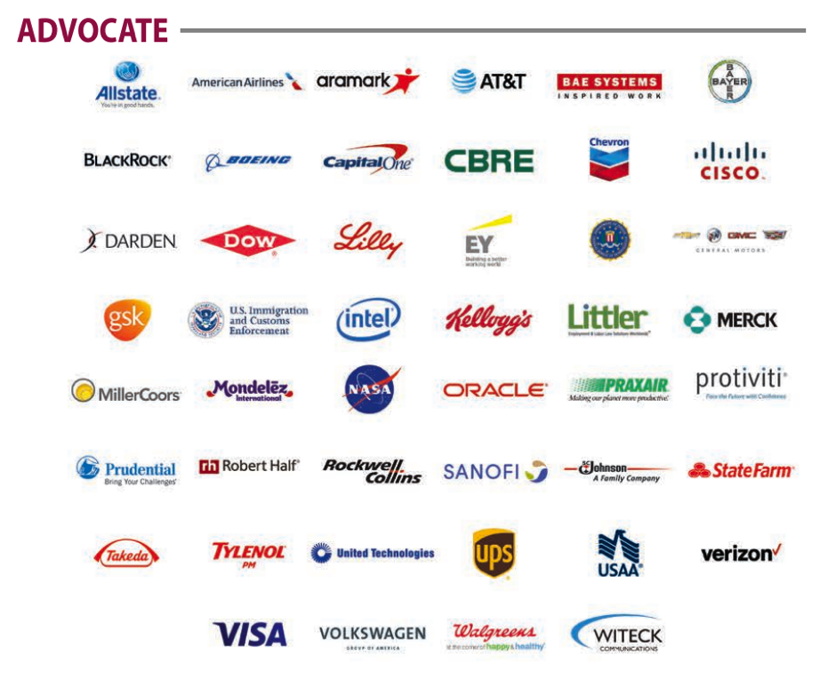
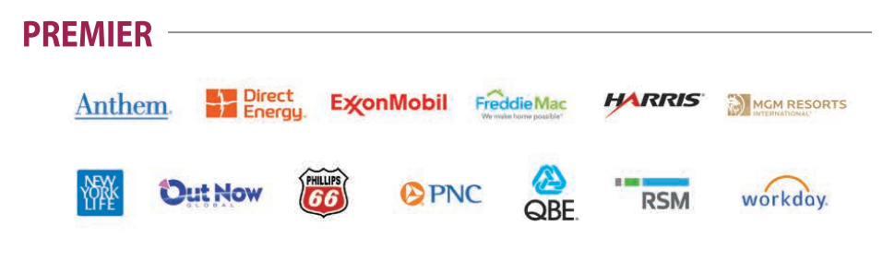
2016 WORKPLACE SUMMIT SPONSORS

Slide 12


Top 5 companies with largest delegation at Summit
(129)
(100)
(80)
(75)
(70)

Slide 13
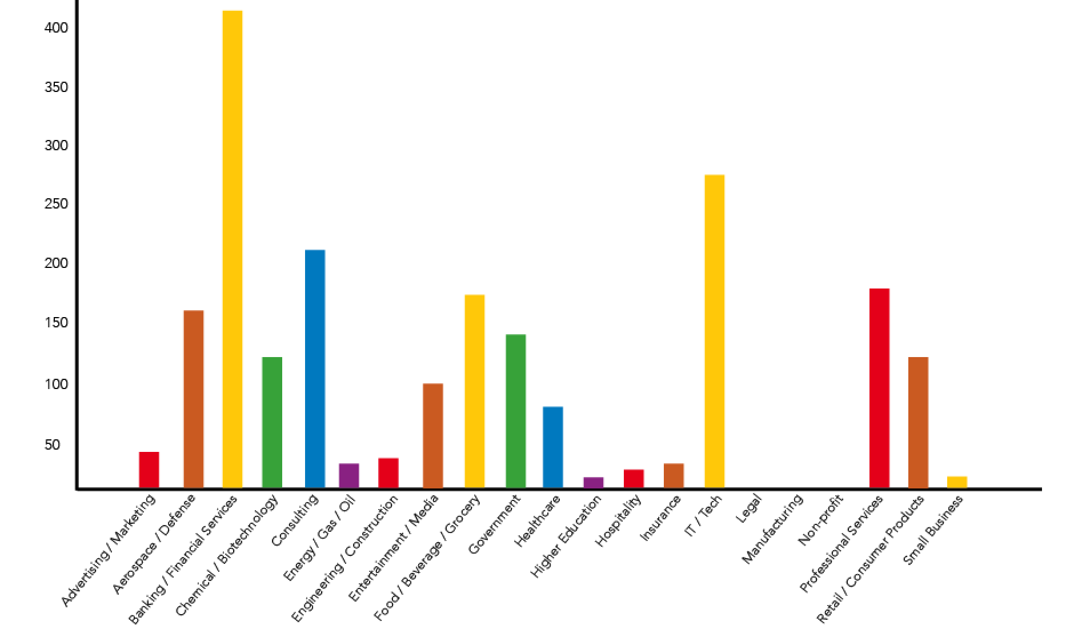
Representation by Industry

Slide 14
Business Case
Partnership with Out & Equal at the Workplace Summit provides a number of benefits to companies and government agencies.
Visibility: Visible corporate support and participation reinforces company brand and reputation as an employer of choice for the Lesbian, Gay, Bisexual, Transgender and Ally (LGBTA) community. Sponsors are offered event branding, panelist and speaking opportunities, ad placement in the Summit Program Book, logo in the video sponsor reel at all plenaries, and a company booth in the Engagement Center.
Empowerment: A rich series of 107 workshops, 7 roundtables, 6 special topic featured panels, 3 plenaries, 3 ticketed events and 20 global workshops geared for companies and their employees at all levels, reinforces organizational values and develops expertise and leadership skills in response to emerging LGBTA workplace issues.
Education: Essential for companies to be on the leading edge of matters important to LGBTA employees, the Workplace Summit offers education, leadership development, best practices and tools to advance Diversity & Inclusion Initiatives both nationally and globally.

Slide 15
Attendee comments
“This Summit opened my eyes in so many ways. Especially around the need for measures and metrics to ensure we are included. That is an effort I think will take quite some time for my company and we need examples to follow.”
“This was my first Summit and I hope it is the first of MANY more. This event was an event I will never forget. Not only did I learn so many new and wonderful thing, I made connections that I know I will have for a lifetime. Thank you for ALL you do, because you truly have changed my life.”
“I bonded with my team, most of which I didn't know and got much closer with all of them. You get connected in a way you wouldn't connect at work. I learned so much at the workshops. The amount of new friends and connections I've made is unbelievable. People from all over the world and country, it's great to meet such a great group of individuals that all have one goal, to make the workplace a safe environment for everyone! Thank you for the amazing experience and wonderful memories. I really hope to attend this conference again in the future.”
“I could not be more pleased with the Summit this year. This is my 3rd time attending and I thought the communications, pre-summit meetings, location, and overall organization was "spot on!” I was very excited for the wide range of topics and I felt there was a key focus on areas that may have not had such a focus in the past (Example: topics around Transgender). I feel each time I attend I grow as a person both professionally and personally and I, in my heart, feel I have the opportunity to help others grow as I make connections during the Summit.”

Slide 16
Attendee comments
“I have been to the last 7 Summits and was very impressed that O&E has begun to include the Government Sector into the universe of work. O&E has become more aware of the pitfalls and limitations for a government employee to officially attend O&E and made provisions to allow employees to work within our regulations and provide an option for our attendance. Bravo!”
“This was my first Summit and I can't say enough about how wonderful the experience was for me. My local chapter of our ERG just began in July and I'm extremely energized and excited to make our local group a shining star. Most of the workshops I attended were very well presented and inspired me to try for a presenter spot next year.”
“I had a fantastic time. I made many new professional contacts. Everyone associated with the Summit was wonderful: the volunteers, the board and the staffs at the Swan, the Dolphin and the Yacht and Beach Club. I am presenting my report to my entire management staff tomorrow.”
“The overall Summit was great. I was equally impressed by how the conference managed to keep going despite the unwanted guest of Hurricane Matthew. It is refreshing to be around fellow LGBTQI professionals and our allies and realize the importance our community has to making the world go round. I left this conference motivated and proud to be a vocal member of our LGBTQI. Kudos to everyone who made this event the success it was!”

Slide 17
Visibility at Events
Throughout the Workplace Summit, companies and government agencies are invited to attend and host events intended to expand the visibility of the company, in addition to educating attendees about the work that is being done to further LGBT workplace equality.
Event | Attendance
HR Breakfast | 372
Women’s Leadership Breakfast | 389
Government Breakfast | 388
Executive Lunch | 164
Board Meet & Greet | 132
Young Professionals Reception | 118
VIP Gala Reception | 335

Slide 18
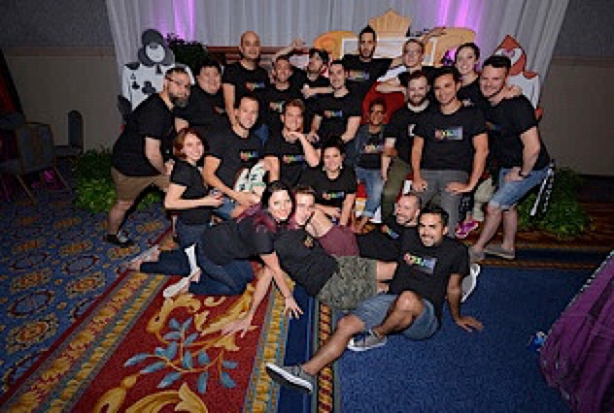
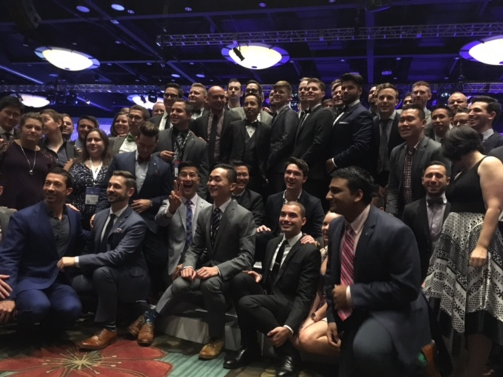
Visibility at Events
Event | Attendance
Cultivating Change Reception | 70
Genentech Reception | 89
Lockheed Martin Reception | 21
Littler Mendelson Reception | 46

Slide 19
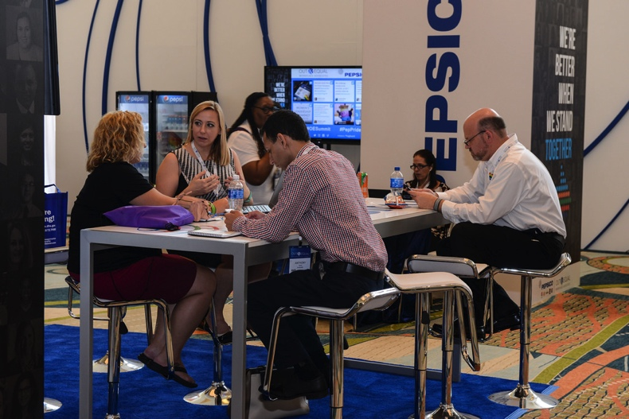
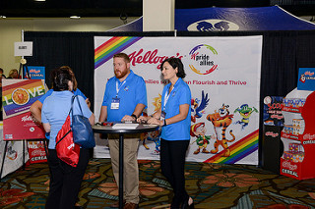
Visibility
Engagement Center, Program Book, Logo Placement
Companies, government agencies, and nonprofit partners seek placement in the Engagement Center to educate Summit attendees about their work, attract professionals looking to expand their career path, and network with other company representatives and establish new contacts and share new ideas. Full page, half page and quarter page ads appear in the Summit Program Book, and logo placement is featured for hosted/branded events and the plenary session video sponsor reel.

Slide 20
Empowerment – OUTIE Awards
There are 4 Outie Awards that are announced at the Summit plenaries. These highly competitive awards honor individuals and organizations who are leaders in advancing equality for LGBT employees in the workplace. Through these awards, Out & Equal recognizes innovative approaches, thought leadership and proven successes to help create safe and equitable workplaces. (Winners indicated in red below).
LGBT Employee Resource Group of the Year Finalists & Winner | Champion Award Finalists & Winner | Workplace Excellence Award Finalists & Winner
Blue Cross Blue Shield of Massachusetts/Blue Pride | Shannon White/Northrop Grumman | Bank of America
CIA | Gina McCarthy/US EPA | Dell
IBM Philippines/IBM Eagle | Michelle Smith/Boeing (tie) | BNY Mellon
Wells Fargo/PRIDE Team Member Network | Thomas Vilsack/USDA (tie) | Cisco Systems
Walmart/Walmart PRIDE | Roberta Smith/State Farm | Intel
US Intelligence Community/IC Pride

Slide 21
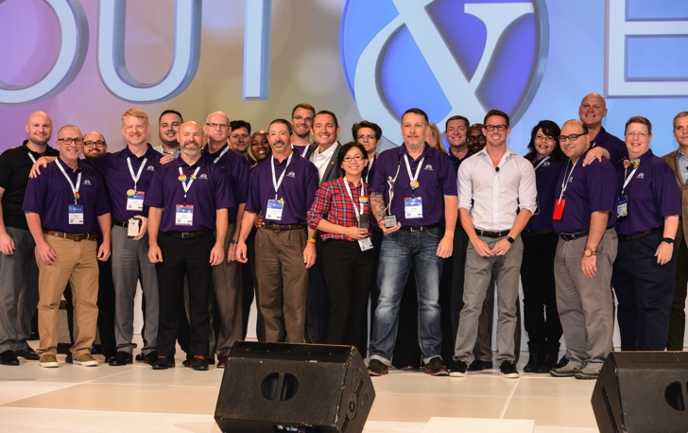
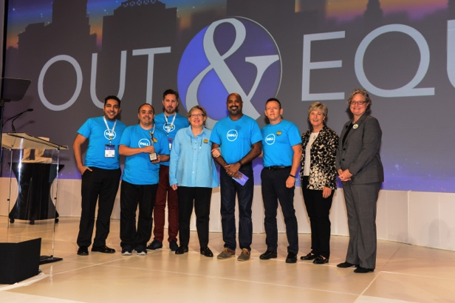
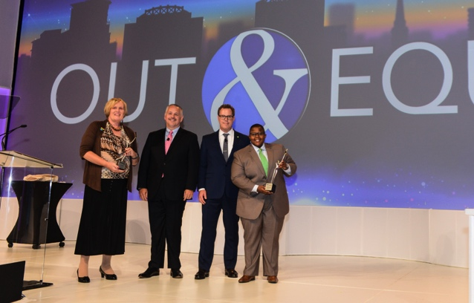

2016 Outie Award Winners
LGBT ERG of the Year:
Wells Fargo Pride Team Member Network
Workplace Excellence: Dell Inc.
Champion: Michelle Smith
& Tom Vilsack
Excellence in Government
Leadership Award: CIA

Slide 22
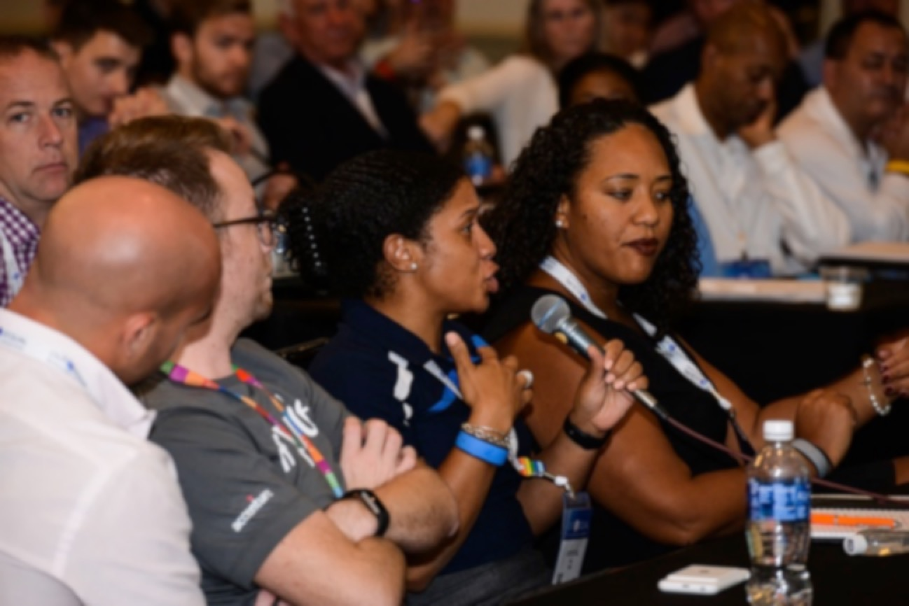
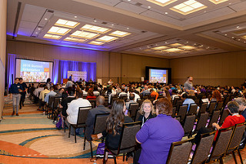
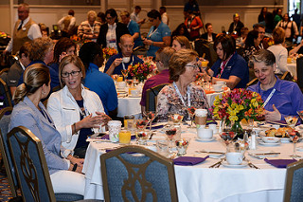
Education
At workshops and roundtables, subject matter experts presented best practices, data, case studies and best practices in eight tracks:
Allies, Beyond LGBT Diversity, Building Executive Leadership, ERGs/BRGs, Global, Law, Policy & Benefits, LGBT Marketing, Professional Development, LGBT Recruitment, Retention & Promotion and Transgender
Featured Panels showcased speakers from leading companies and organizations with expertise in Allies, Diversity & Inclusion Business Cases, Global, Public Policy, Diversity & Inclusion Business Cases, LGBT Global, Public Policy, LGBT Recruitment, Retention and Promotion, and a special panel in honor of the survivors and lives lost in Orlando, the role of corporate philanthropy and lessons learned.

Slide 23
Summit Highlights
Opening Brunch sponsored by The Walt Disney Company featured the cast of The Lion King, a welcome from Mayor of Orlando Buddy Dyer and a keynote by Abby Wambach, Olympic Gold Medalist and FIFA Women’s World Cup Champion.
Power Lunch Plenary sponsored by Dell with a performance by Diana King, and keynotes by Diana Nyad, long distance swimmer and author; Selisse Berry, Founder & CEO and Lance Bass, entertainer and actor.
Gala Dinner Celebration sponsored by Out & Equal featured Apoorva Gandhi, VP of Multicultural Affairs, Marriott International, a spirited Live Auction and a performance by the Plain White T’s.
Ticketed Events:
HR Breakfast sponsored by Marsh & McLennan Companies panelists featured Mark Boire- General Manager, Toyota; Jim McNasby- General Counsel, Marsh & McLennan Risk & Insurance, and Vadim Thomas- Inspector, FBI
Women’s Leadership Breakfast sponsored by Altria panelists featured Margot Slattery, President, Sodexo Ireland; and Cindy Armine-Klein, EVP Chief Control Officer, First Data
Government Breakfast sponsored by Northrop Grumman panelists featured Jeff Marootian, Assistant Secretary U.S. Department of Transportation; Ivan Scalofrito, Member of Parliament Italy, and Ashlee Davis, White House Liaison, U.S. Department of Agriculture
Executive Events: Executive Luncheon, Out & Equal Board Meet & Greet and Executive Forum Reunion

Slide 24
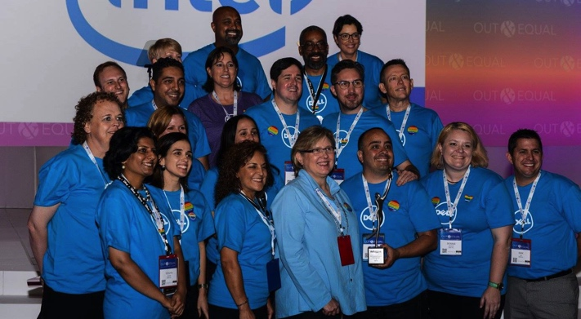
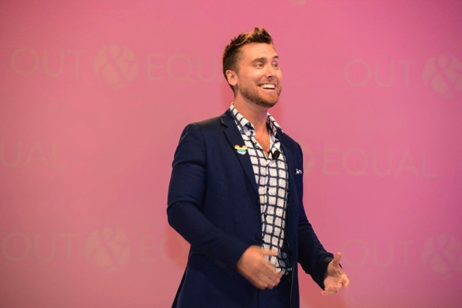
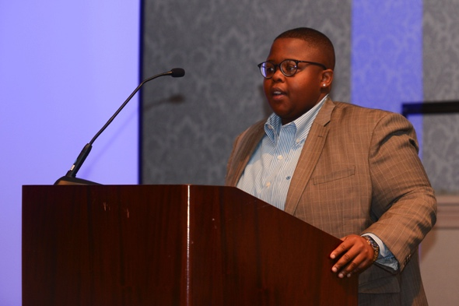
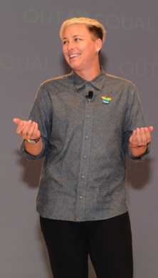
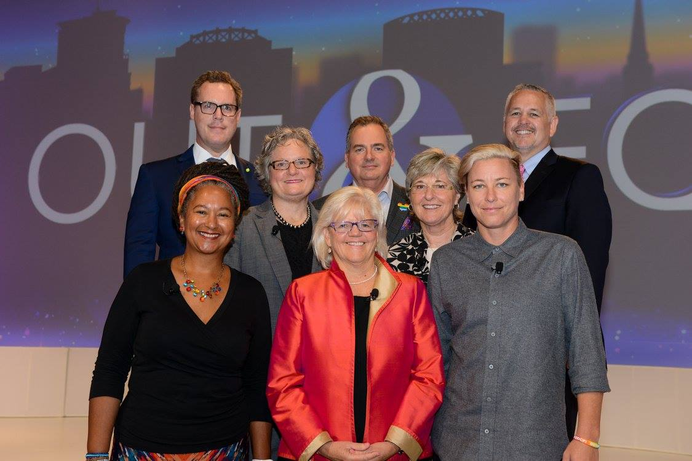
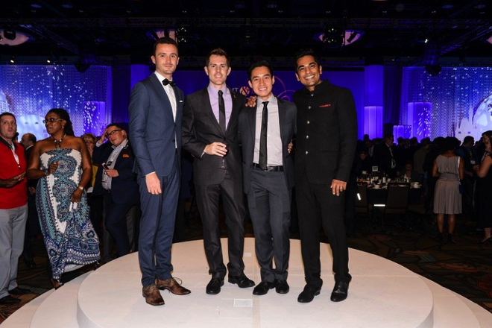
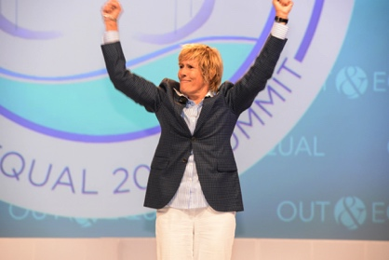
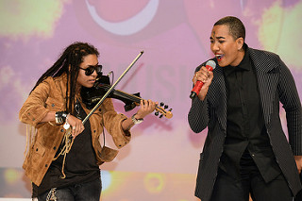
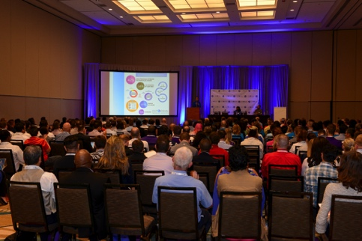
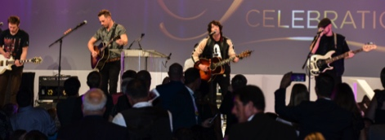
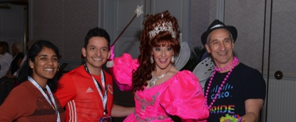
Summit Highlights

Slide 25
Summit Highlights
Featured Panels:
Global -This panel focused on our interconnectivity, understanding global cultures and the issues facing LGBT employees around the world, which is becoming increasingly becoming more important. We know that multinational companies face the challenge of implementing culturally sensitive LGBT programs for both local employees and expats around the world—this panel aimed to share best practices in addressing those challenges and helped attendees gain insight into the ways in which your organization can best support global LGBT mobility.
Recruitment and Executive Promotion -This panel focused on HR strategies for recruiting and retaining LGBT employees and highlighted how these employees offer an opportunity to lead the field in developing and sustaining diverse talented workforces. Whether through targeted recruiting and networking events, job fairs, or though engagement with Out & Equal’s LGBT CareerLink, LGBT-specific recruiting is critical to building inclusive, diverse and competitive workforces—this panel aimed to share best practices in leading practices for attracting, hiring, and retaining an LGBT talent pool.
Orlando - As thousands of LGBTQ and Ally advocates gathered to discuss workplace equality during Summit, we also sought to honor and remember survivors and lives lost after the unspeakable tragedy in Orlando. This panel provided a high-level overview of responses to the mass shooting at Pulse, including what help was needed then, now, and in the future. Community organizers provided updates on what’s happened since June 12 and helped attendees get a sense of what remains to be done and how they can help. The panel also addressed challenges, the role of corporate philanthropy in responding, and lessons learned.
Public Policy- The historic gain of same sex marriage equality in all 50 states, the achievement of full LGBT rights and equality remains at the forefront of various local, state, and federal public policy debates. From religious based discrimination to prohibitive usage of public facilities by transgender people, and more, corporate leadership has emerged as an especially key voice in the debate. This panel focused on corporate pushback against anti-LGBT legislation and explored the challenges and best practices for engaging corporate and business interests in emerging LGBT concerned public policy debate.

Slide 26
Summit Highlights
Featured Panels continued:
Business Case- Diversity & Inclusion (D&I) has become an integral part of business today. Promoting a climate of cultural competency increases engagement, satisfaction and ultimately recruitment and retention of employees. Over the years, race, age, pregnancy, disability and many more dimensions of diversity have been included in the workplace and have been protected by state and federal laws. One of the newest groups to emerge in the workplace are lesbian, gay, bisexual and transgender (LGBT) employees. This panel focused on how to best make the business case for equality and energize the company to invest in LGBT equality.
Allies and Advocates - This panel focused on the role of allies in LGBT inclusion and best practices for encouraging allies to be engaged advocates. This panel discussed the benefits of “coming out” as an ally, responsibilities of allies in the workplace, shared lessons learned at their respective companies, and strategies for including and leveraging allies in your workplace’s LGBT employee resource group.
Case Studies presented by PepsiCo, IBM, Wells Fargo, McDonald’s and Mass Mutual
Out & Equal’s Workplace Summit LGBT Film Series

Slide 27
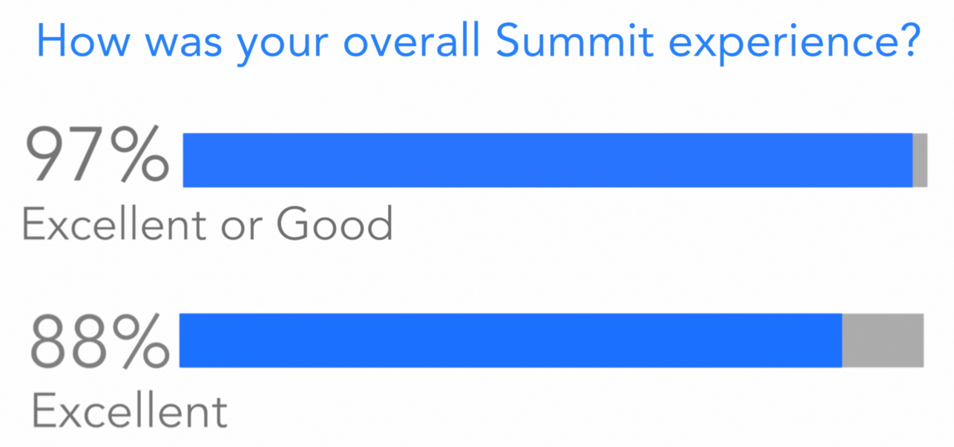
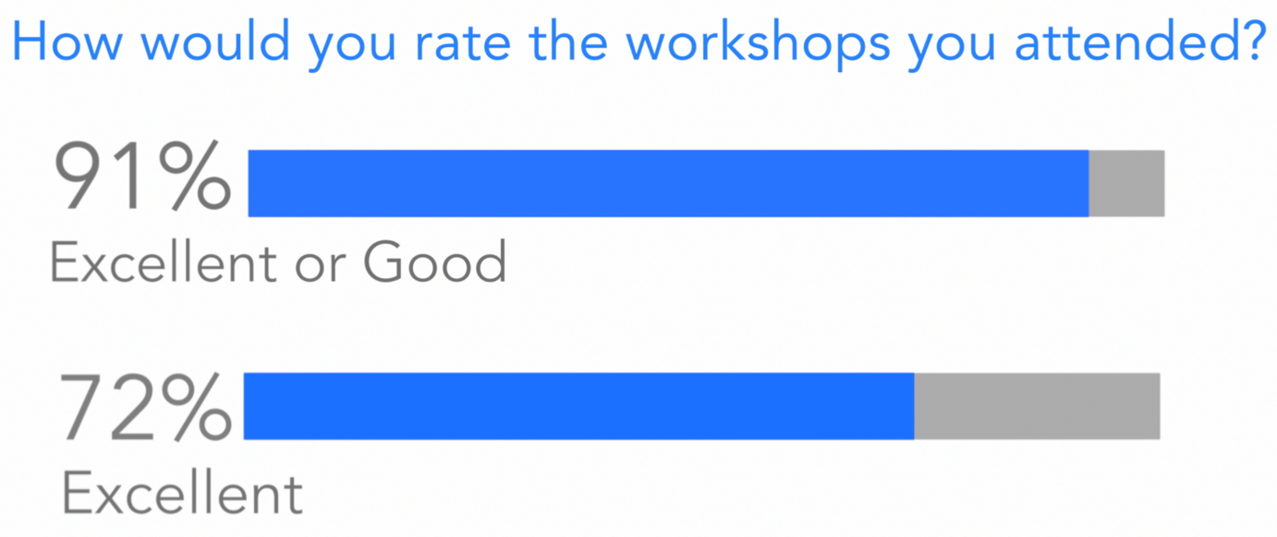
SURVEY STATISTICS

Slide 28
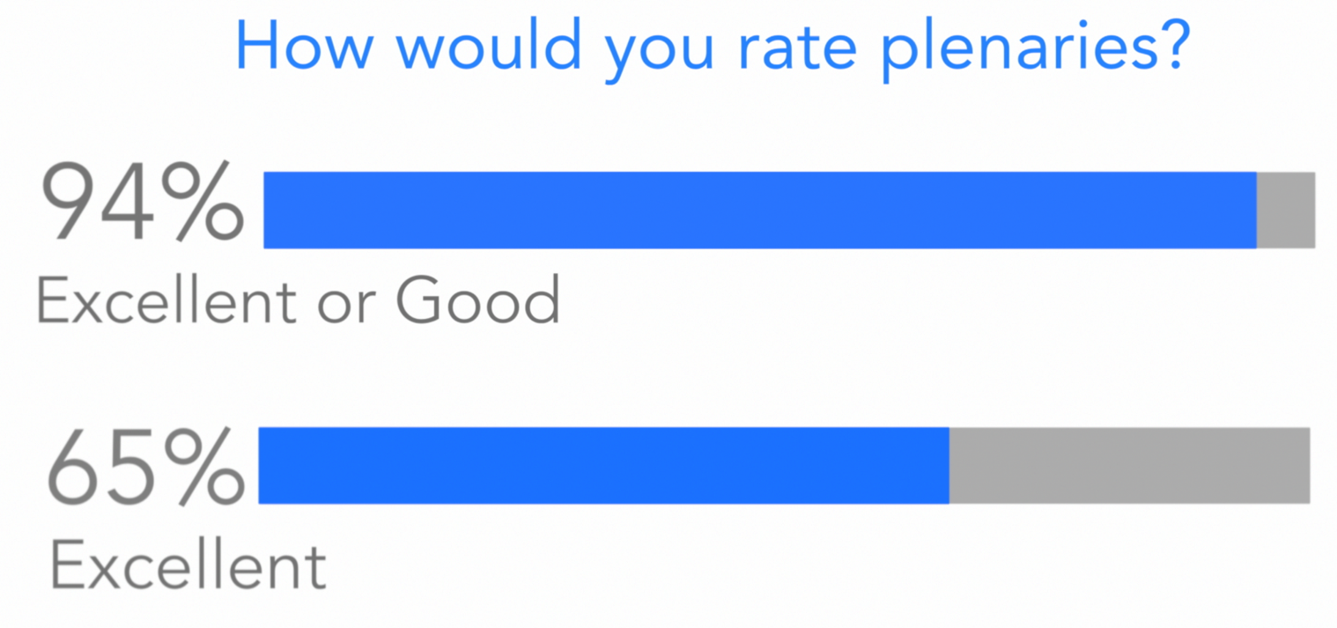
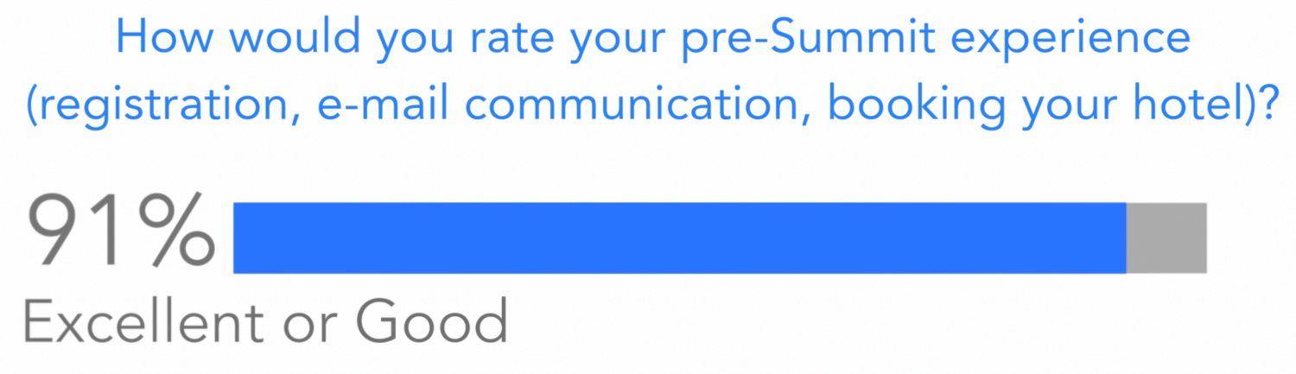
SURVEY STATISTICS

Slide 29
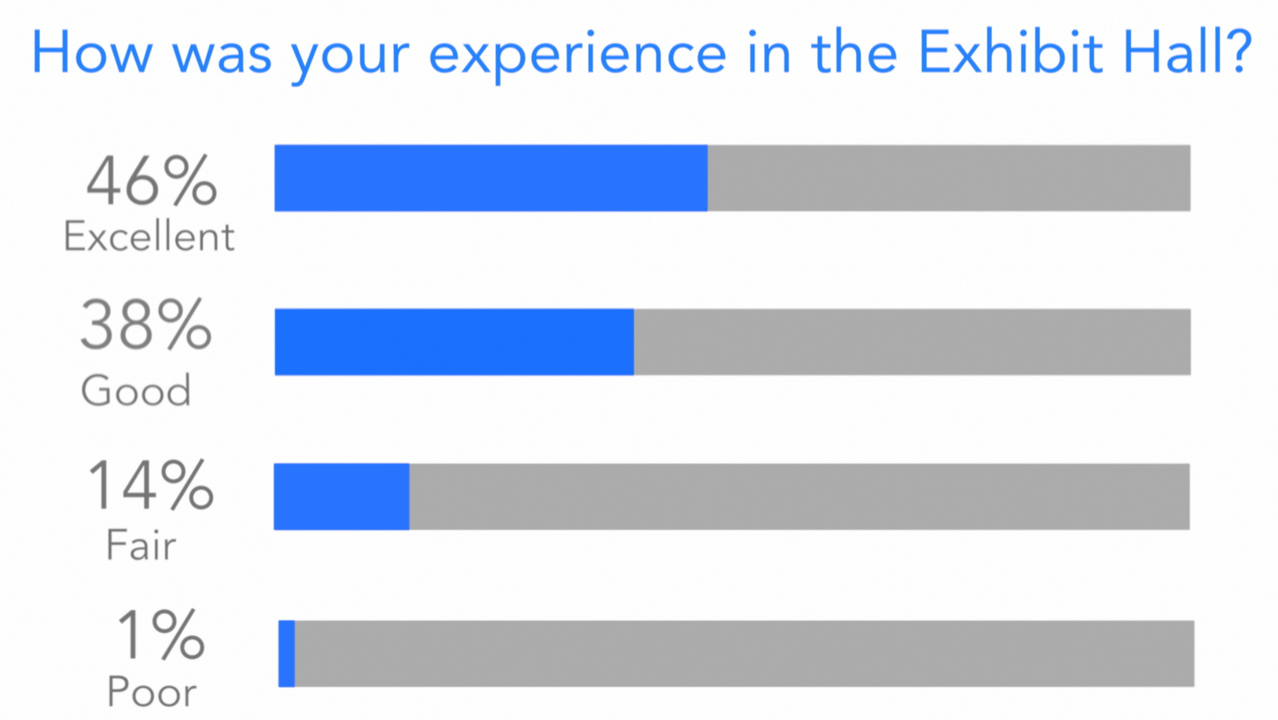
SURVEY STATISTICS

Slide 30
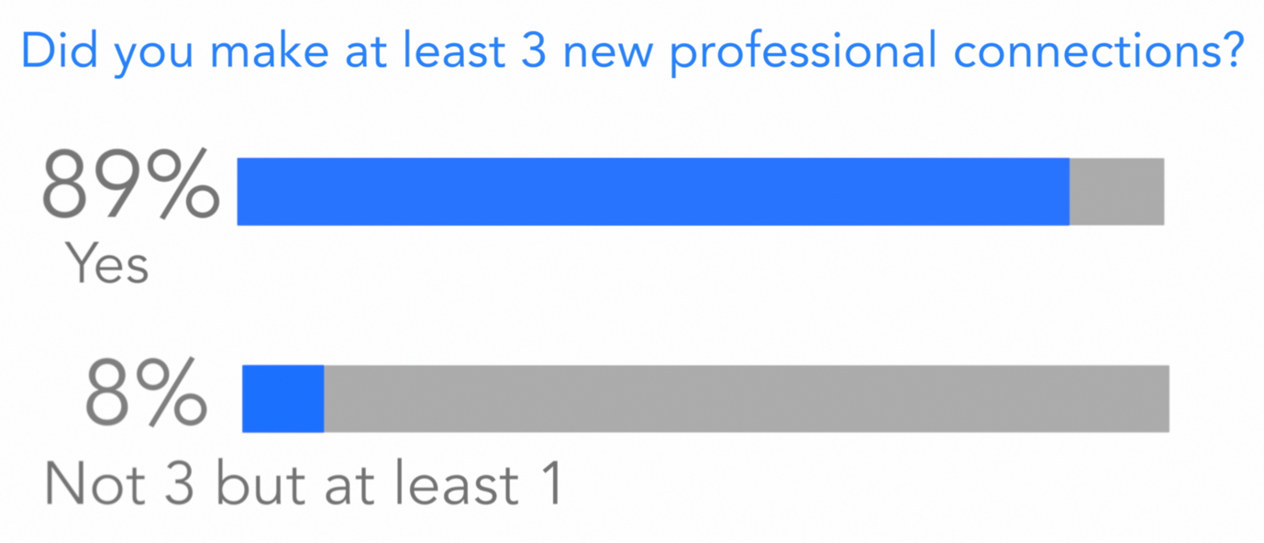
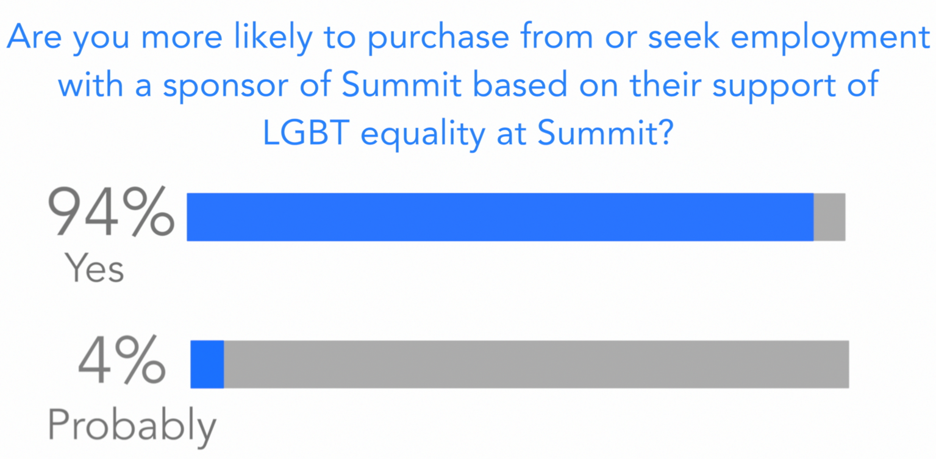
SURVEY STATISTICS

Slide 31
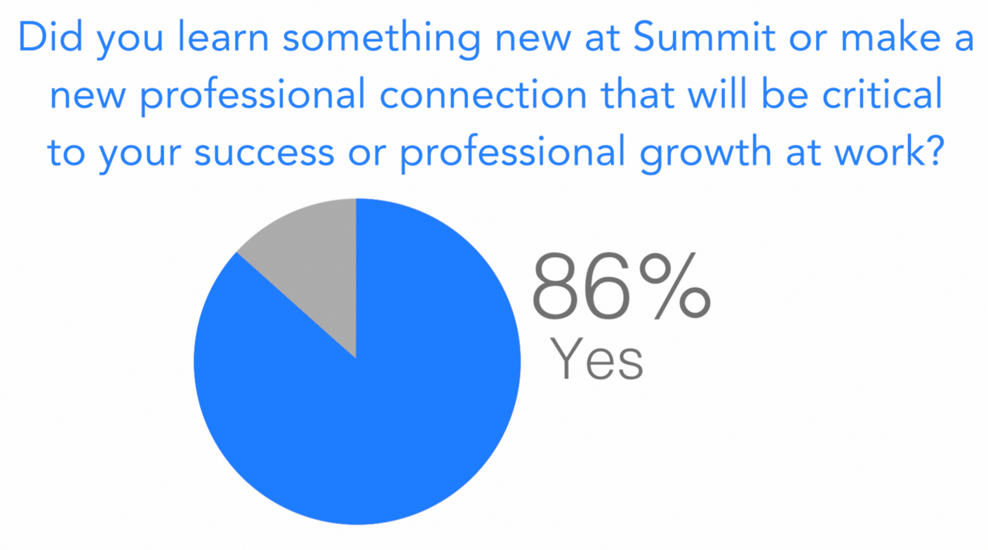
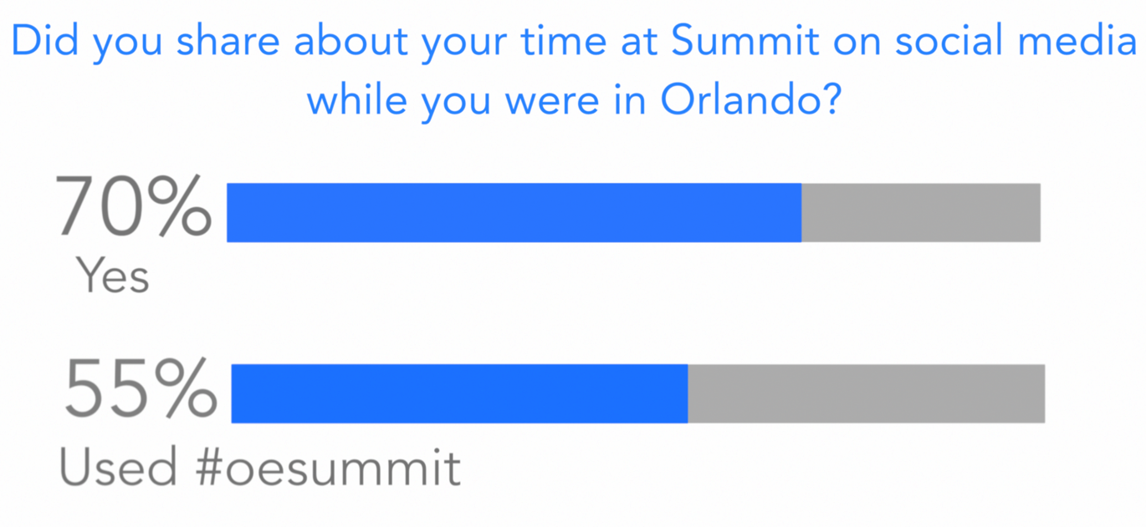
SURVEY STATISTICS

Slide 32
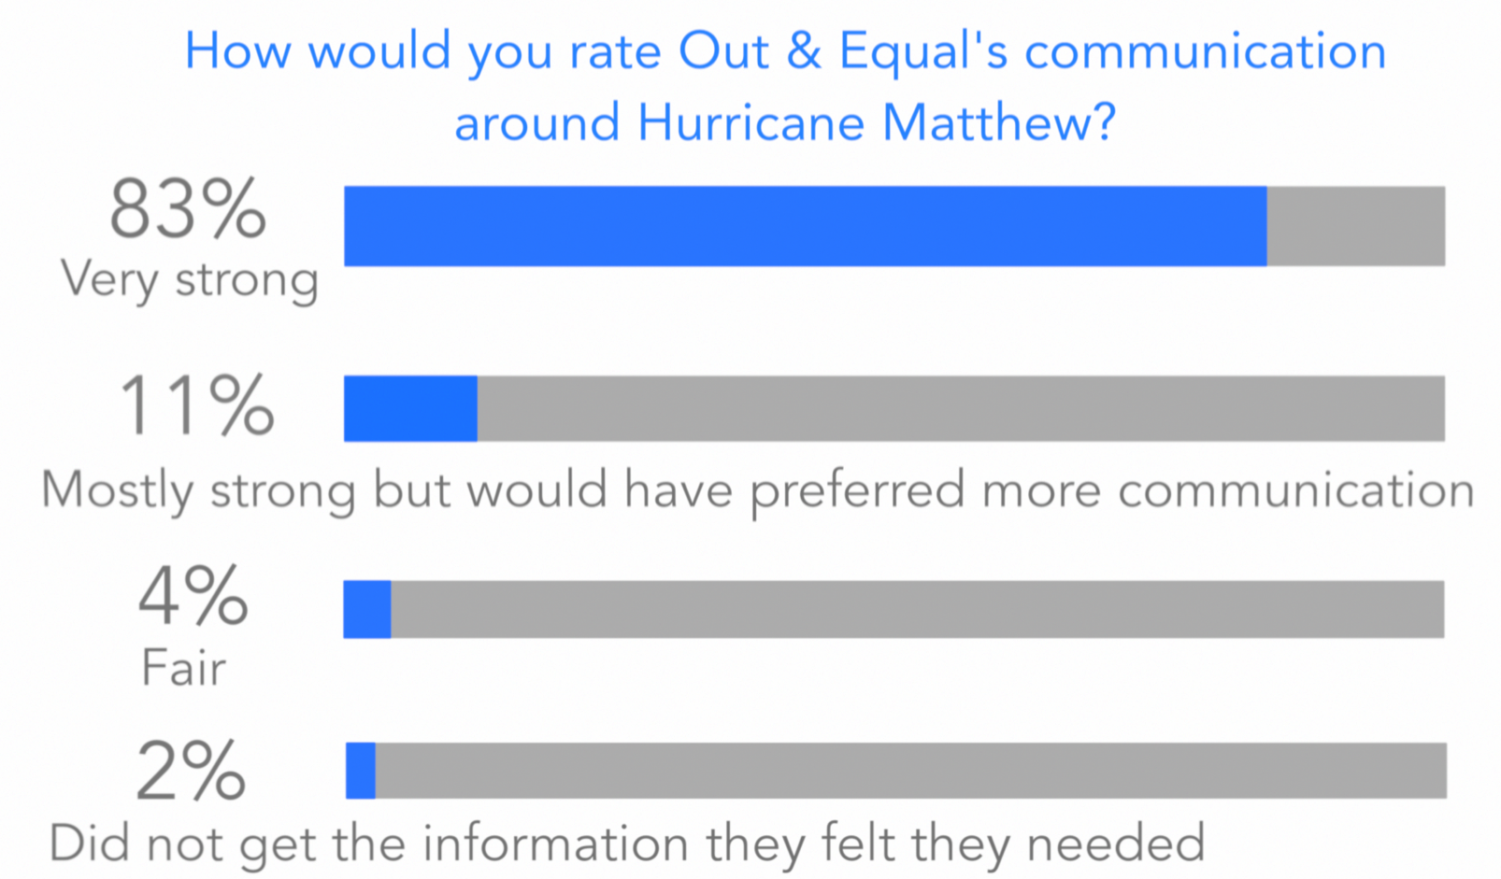
SURVEY STATISTICS

Slide 33
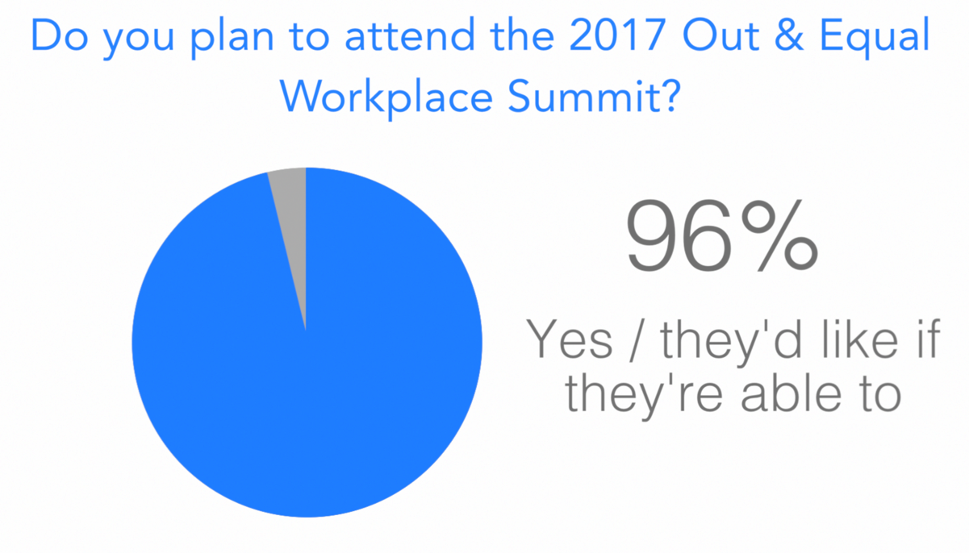
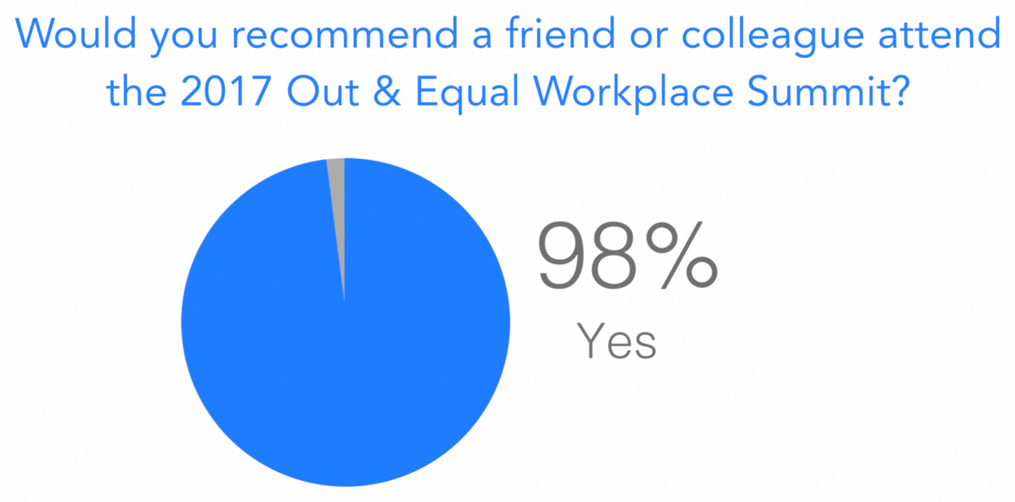
SURVEY STATISTICS

Slide 34
2016 SUMMIT LINKS
Highlights Video
Summit Photos
Keynote Speeches
Workshop Presentations

Slide 35

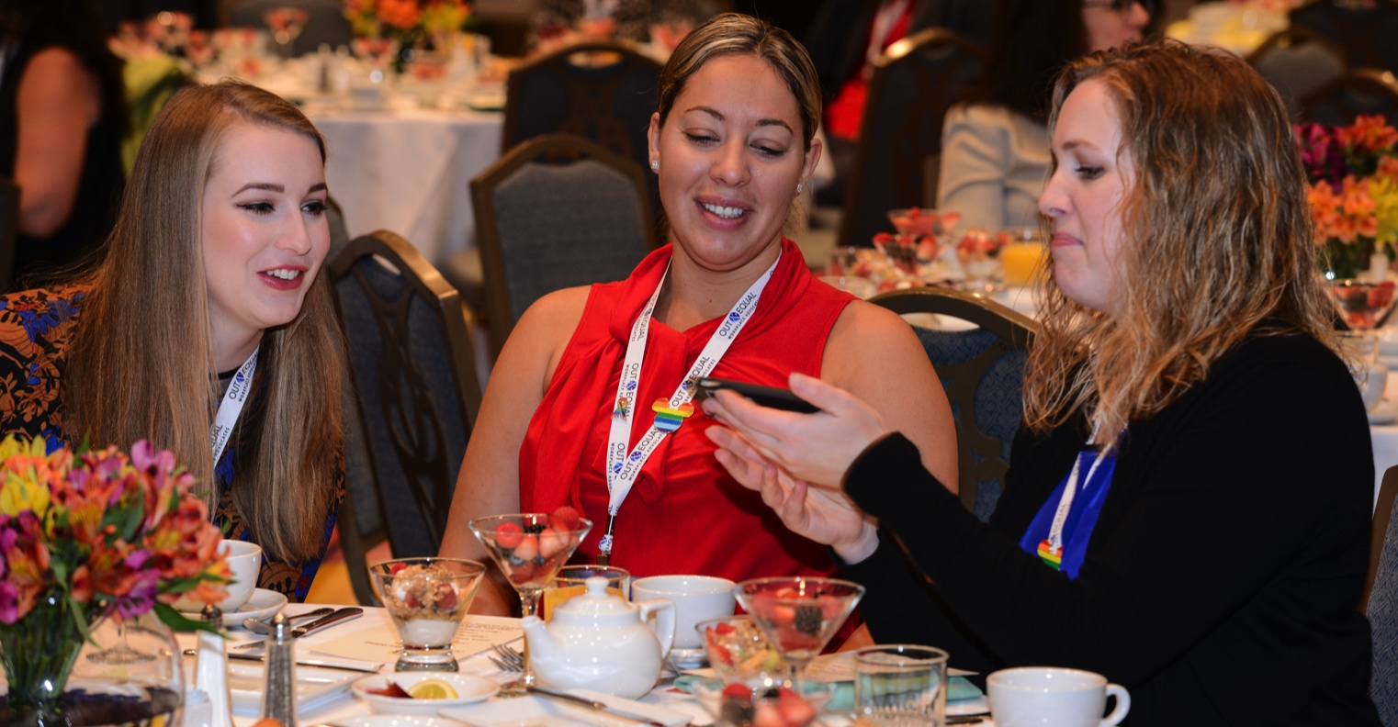
Connect
@outandequal

Slide 36
Resources & Contacts
Education
To learn more about Education and Professional Development opportunities, please contact
Daniel Lawrence Smith, Director of Education at dsmith@outandequal.org.
Partnership
For more information about year-round partnership opportunities, please contact
Stephen Huey, Director of Corporate Engagement at shuey@outandequal.org
Global
To learn more about our Global Initiative Program and how your company can become involved, please contact Steve Roth, Director of Global Initiatives at sroth@outandequal.org.

