Slide 1
Fertility Options Specifically for LGBTQ Patients
Mark P. Trolice, M.D.

Slide 3
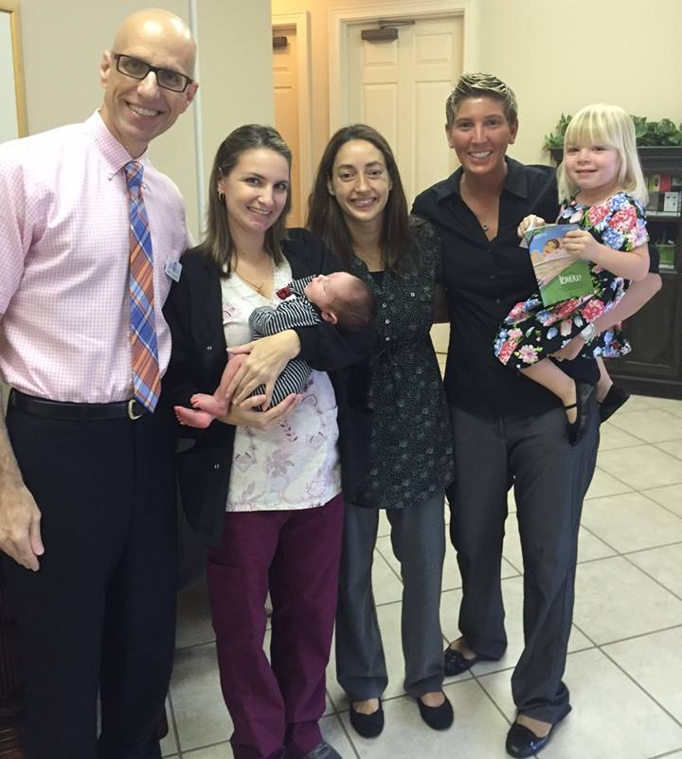

Slide 4
Family Building
Physical
Emotional
Financial

Slide 5
CARE at a Fertility Clinic
Communication
Accommodation
Relaxation
Education

Slide 6
For Women

Slide 7
Ways to Conceive for Lesbian Couples
Intrauterine Insemination (IUI)
IVF with own patient’s eggs
Egg sharing (between the couple)
Adoption

Slide 8
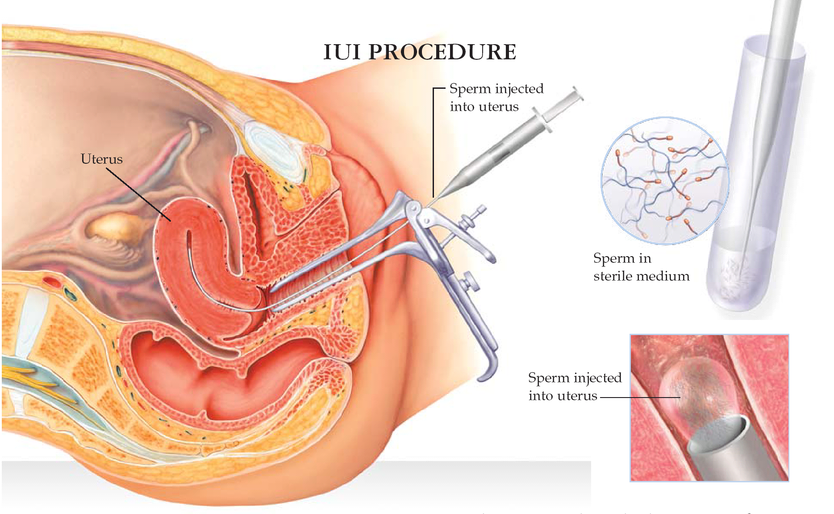
Intrauterine Insemination (IUI)
Artificial Insemination
Donor sperm screening
Anonymous or known
Vaginal insemination

Slide 9
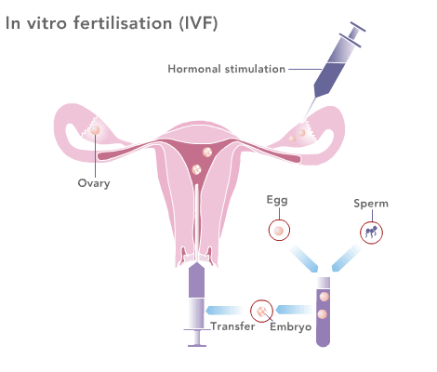
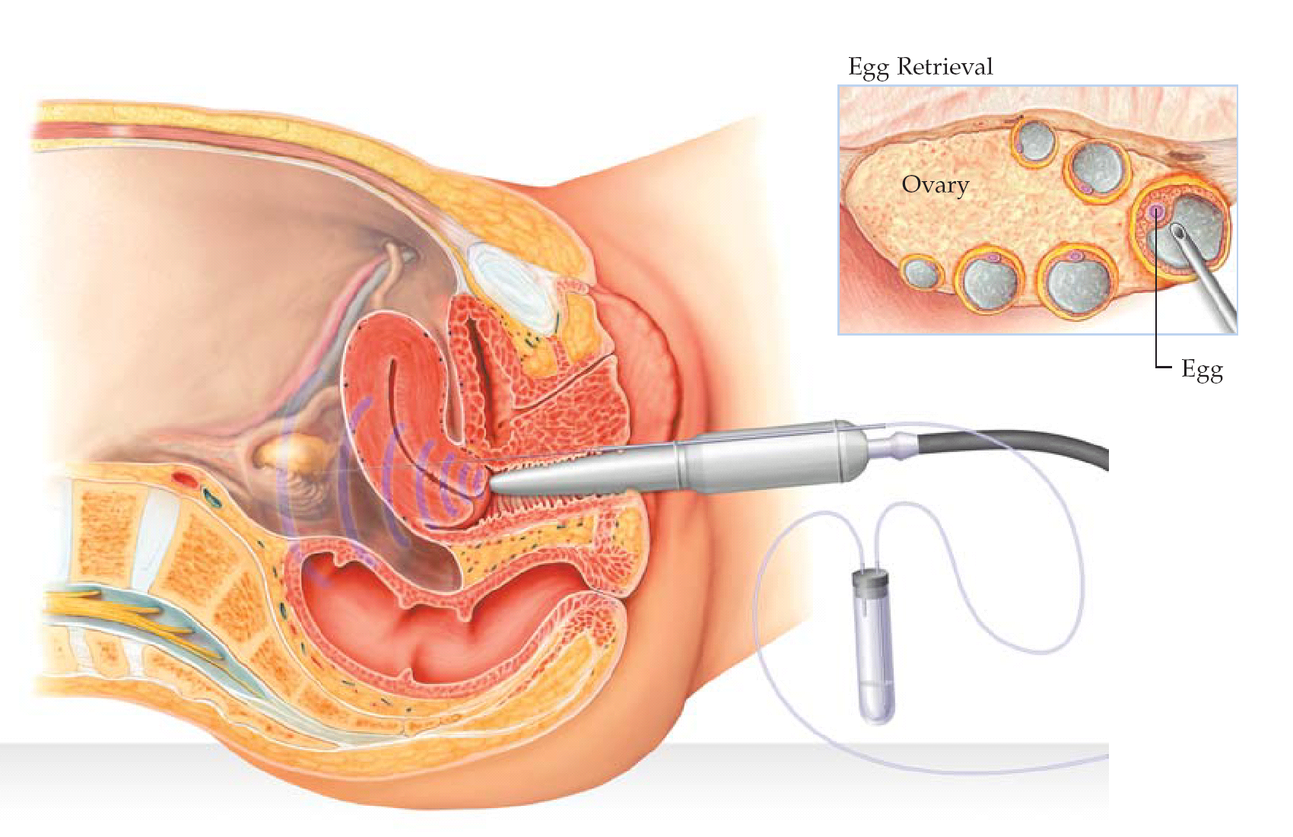
In-Vitro Fertilization (IVF)

Slide 10
IVF With One Person Eggs
Egg Sharing between couple

Slide 11
Egg Sharing
Involves giving half of your total eggs collected during your IVF cycle to an anonymous recipient
Allows both couples to have a chance of having a baby through fertility treatment

Slide 12
How Can Lesbian Couples Share Eggs?
One partner provides the eggs (the genetic mother) and the other carries the pregnancy (the birth mother).

Slide 13
Should I Freeze My Eggs?
Single women
Lesbian couples
Transgender

Slide 14
For Men

Slide 15
What Options Do Male Same Sex Partners Have When Trying to Have a Baby?
Egg donation
Surrogacy
Traditional
IVF
Adoption

Slide 16
What is Egg Donation?
For women who lack ovarian function secondary to ovarian failure, chemotherapy, radiation treatment, genetic diseases
An oocyte donor receives ovarian stimulation
Retrieved eggs are mixed with the recipient’s partner’s sperm
Resulting embryos are transferred to the recipient

Slide 17
What is Surrogacy?
Traditional vs. IVF

Slide 18
Adoption
International Adoption
Domestic Adoption
Foster Parenting

Slide 19
Summary of LGBT Family Building
Lesbian Couples
Donor sperm IUI
Donor sperm IVF
Shared egg donation
Gay Male Couples
Traditional surrogacy with IUI
IVF surrogacy with egg donation
Adoption

Slide 20
LGBTQ Family Building Resources
The American Society of Reproductive Medicine (ASRM)
The Gay and Lesbian Medical Association (GLMA)
Fenway Health
Gay Parent Magazine
It’s Conceivable

Slide 21
Thank You!
Questions?

