Slide 1
Reverse Mentoring Handbook
The PRIDE GUIDE -
Leading our Leaders through LGBT Inclusion

Slide 2
What is Reverse Mentoring?
Reverse Mentoring provides a forum for our diverse LGBT employee talent to coach, train and develop our leadership team around LGBT diversity issues in the workplace.

Slide 3
What is Reverse Mentoring?
Reverse Mentoring cultivates a symbiotic relationship where our management and senior management develops long-term partnerships with employees from all backgrounds to lead each other to a diverse, inclusive future at Lilly.

Slide 4
What is Reverse Mentoring?
Reverse Mentoring is simple, safe, confidential, and informal, yet powerfully transformative for both the mentor and the mentee.

Slide 5
How does Reverse Mentoring Work?
Each mentee is paired with two mentors based on topics that the mentee might like to learn more about and in a way that maximizes cross business unit or workgroup relationships.
The mentors and mentee determine the specific number of touch points; the suggestion is a minimum of four touch points for 30-60 minutes (preferably face to face or video conferencing) every 3-4 weeks over the course of 5 months.

Slide 6
How does Reverse Mentoring Work?
Each meeting will include an item of pre-work determined by the mentors which may involve reading a brief article, participating in an activity/experience or watching a video about a pertinent topic.
Each guided meeting will progressively build on the mentor/mentee relationship developing a mutual sense of trust and safe space and confidentiality for each participant to engage, learn and develop.

Slide 7
How does Reverse Mentoring Work?
The meetings will include several key talking points or questions for participants to discuss in a safe, informal manner.
At the end of the 4-6 meetings, mentors and mentees will complete a brief survey about their thoughts, key takeaways, and suggestions for improving the process in the future.
After the conclusion of the program, the mentors and mentee are strongly encouraged to maintain active communication and partnership into the future based on the needs of the mentors and mentee as they see fit.

Slide 8
Timeline-
VOLUNTEER
PAIRED
MEETINGS
SCHEDULED
REGULAR
MEETINGS
MEETINGS
CONCLUDE
ACCOUNTABILITY
Mentors and mentees volunteer by June 1 for Wave Three.
Mentors and mentees are paired and project launches June 15, 2016.
Mentors will reach out to mentees to schedule meetings between June 15, 2016, and July 1, 2016.
Meetings will take place between July 1, 2016, and December 1, 2016 (Approximately one call every 3-4 weeks).
Wave Three structured meetings conclude December 1, 2016, and participants receive a survey via e-mail to be completed by December 10, 2016.
Accountability - Due to limited space, if a mentee is unable to commit to the minimum of 4 scheduled calls during the timeline, mentee needs to tell her or his mentors so they can be removed from this wave to make room for a mentee on the waiting list.

Slide 9
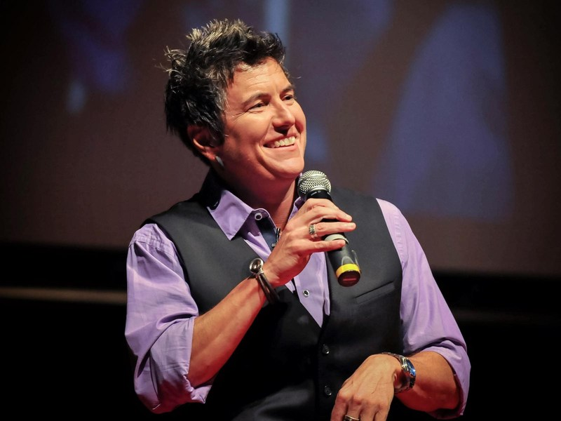
Sample Pre-Work Ideas- Mentors Choose for Mentee
Watch Ash Beckham-Coming Out of Your Closet
View Ted Talk Interview http://youtu.be/E0M1beV91js, Jennifer Brown, Finding your Voice at Work
View Ted Talk Interview http://youtu.be/bd2WKQWG_Dg, Mike Robbins, Bringing your Whole Self to Work
Visit the Straight for Equality Website and Read One of the resources on Becoming a Good Ally in the Workplace or in Healthcare Equality Resources
Watch the Lilly It Gets Better Video Lilly-It Gets Better, browse other It Gets Better videos
Sign up to follow the PRIDE Loop group to receive PRIDE email communications on Lilly Loop
Watch Sexuality and Gender 101 Sexuality and Gender 101
Watch Bisexuality Video Bisexuality Video
Visit the HRC Website and view several coming out stories http://www.hrc.org
Visit http://www.transequality.org/Resources/ to learn more about transgender issues
Mentors remember that your own story is the most powerful resource you have

Slide 10
Prior to the first meeting
Coordinate with your other mentor to decide who will take the communication lead with the mentee and agree on a mutual time that you can both be available for the mentee. Determine how the two of you plan to work together PRIOR to reaching out to the mentee. One person can be the lead or you can alternate, but don’t send out multiple or conflicting schedules or timelines.
Introduce yourselves to your mentee via a joint e-mail. Include the best way to contact you and ask how they would prefer you to contact them.
Develop a communication strategy between mentors and mentee (link, iPad, cell phone).

Slide 11
Prior to the first meeting
Determine the schedule and timing of your meetings being sensitive to the mentee’s schedule. Remember that senior management often has very small windows of flexibility so be extremely cognizant and courteous of your mentee's time.
Communicate with your co-mentor as much as possible before the first meeting to come prepared and ready to be open, honest, and engaged.
Provide any pre-work AT LEAST one week prior to the first meeting and limit it to less than 20 minutes. If it is something you can all do together, that could be even better.

Slide 12
Mentees: Possible Discussion Points
Mentees: What do you hope to learn during the mentoring process? What are your expectations? What is your professional and personal history?
Mentors: Who would you describe as your “family”? What about your family do you feel is similar to a non-LGBT family? What are some ways you feel your family is unique?
Mentees: What experience do you have or have you had working with or interacting with LGBT individuals? Share a specific story about a time when you felt you didn’t fit in with a group. How did you feel?

Slide 13
Mentees: Possible Discussion Points
Mentees: Try an exercise where the mentees spend one day or one week not referencing their personal lives or referring to their significant other or spouse as "my partner.” Discuss on next call key takeaways.
Mentees: How can authenticity and engagement in the workplace lead to better business results and help retain diverse talent?
Mentee: What is one change you plan to implement in the future so that all employees, including LGBT employees, can be their authentic, engaged selves at work? How can your mentors help?

Slide 14
Mentors: Possible Discussion Points
Mentors-Who are you? What is your professional history? What is your personal history?
Mentors-Has there ever been a time when being LGBT has impacted your career in either a positive or negative way? Describe the situation. If you could go back in time, are there different ways to handle the situation?
Mentors-Has there ever been a time where being your authentic, LGBT self helped a business relationship or helped you connect with a coworker? What was the situation?

Slide 15
Continuing the Mentoring Relationship
Follow up with your mentee after the last of the structured meetings to determine a continuing communication plan.
Coordinate with your co-mentor on what you have learned from each other during the process and what you have learned from senior leadership.
Complete the post program survey so we can make changes and edits going in to Wave Four in 2017.

Slide 16
Reverse Mentoring Video
Reverse Mentoring Video - YouTube

Slide 17
CONCLUSION
If you do not intentionally, deliberately and proactively include, you will unintentionally exclude.

